Slide 1
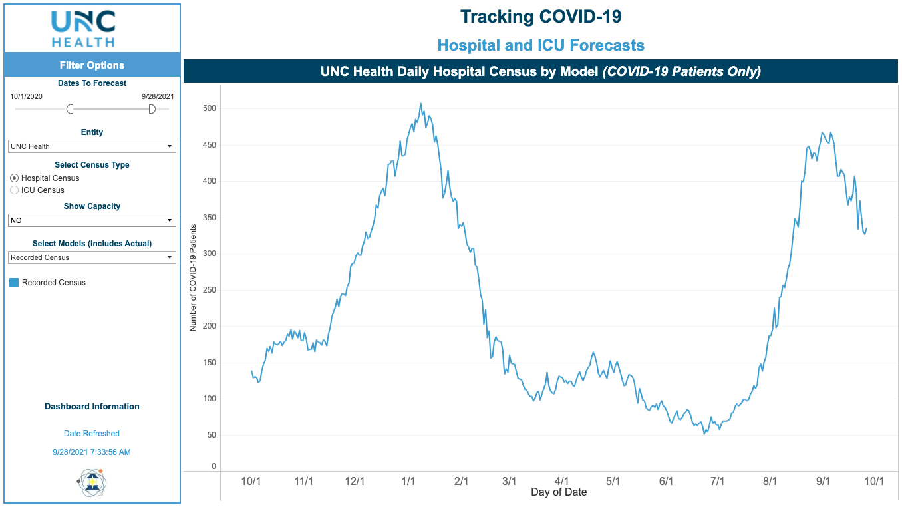
UNC Health COVID-19 Census

Slide 2
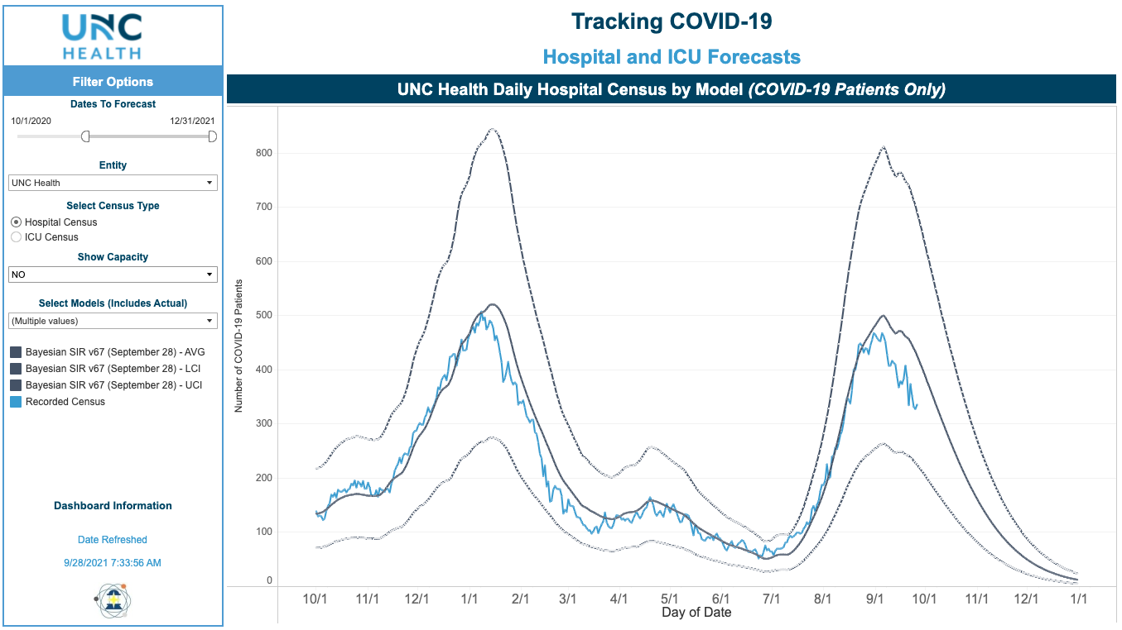
UNC Health observed data and updated forecast range

