Slide 1
GAMEDAY 2021

Slide 2
Goal/Mission
The foundational mission of the University of North Carolina Athletic Event Management Team is to provide an outstanding and unique Game Day experience for all of the Carolina Community Members each and every time (student-athletes, coaches, visiting teams, officials, staff, and fans.
Implicit in this goal is a focus on safety. With the current pandemic, the considerations have been expanded to public and community health considerations that require adjustments and additional considerations. Sporting events and any public gathering has acknowledged and assumed inherent risks, including COVID-19 and the spreading of the Novel Coronavirus

Slide 3
Relationship Building & Continued Operations
UNC Campus EOC/Risk Management/Campus Police
UNC Environmental, Health, and Safety & Emergency Management
Campus Health/UNC Health
Orange County Health Department
Office of the Executive Vice Chancellor and Provost
UNC System Facility and Event Managers
NCAA/Atlantic Coast Conference
NACDA & CEFMA
Peer Institutions

Slide 4
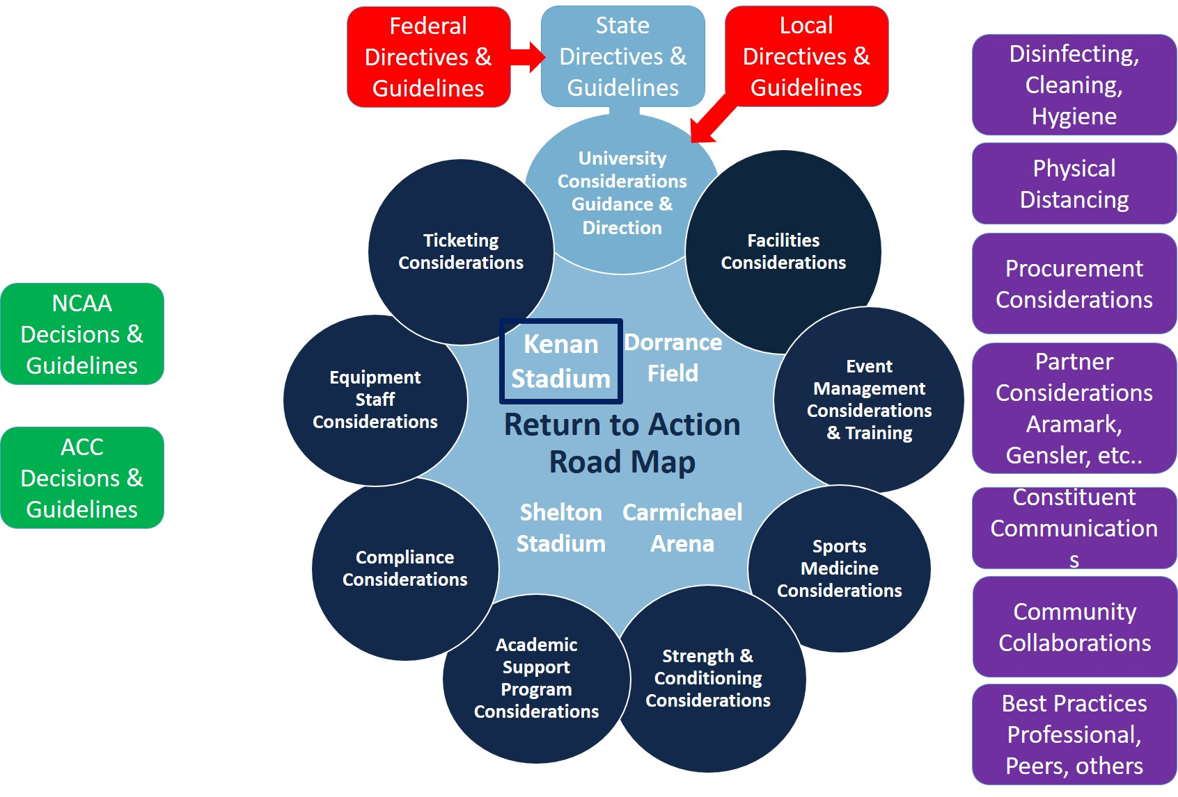
Operational Environment

Slide 5
Continued Approach
Athletic Director/
Athletic Staff
Athletic Teams
Fans/Guests/
Donors
Student-Athlete/
Family Hospitality
Student-Athlete Development
Media
Tar Heel Sports Properties
Rams Club
Rocky Top Hospitality
Ticket Operations
Ticket Sales
Carolina Athletics Hospitality
Compliance
ACC/NCAA
GOHEELS Productions
Computer Services
Aramark Concessions
Sports Medicine
Marketing & Promotions
Equipment
Facilities
EHS/Fire/Emergency Management
Show Pros
Visiting Teams/Officials
Campus Leadership
Transportation & Parking
Campus Safety
Athletics Communications
Game Day Operational Structure
More than 30 Stakeholder Groups coordinating prior to, during, and post Game Day
Operational inefficiencies and striving to create one consensus
Together We Win

Slide 7
Carolina Community Behaviors & Policies
Community Behaviors/Sanitation
Full Capacity
Masks are not required for outdoor events, but must be worn in indoor spaces. This includes restrooms, elevators, the Blue Zone at Football games and transportation services. This is enforced by event staff, security & police indoors)
Pre-communication (emails, social media, press release, web release), Event Facility Signage, Public Address Announcements, Video Board Spots and staff feedback emphasizes strong encouragement to wear masks in crowds
Complimentary masks are available at all gates and fan services locations at Gates 2 & 6
Vaccinations are strongly encouraged, but not required to attend events.
Carolina staff must attest they are vaccinated or must be tested regularly.
All Personnel – (GameDay staff, members of the media, and broadcast staff) must wear a mask in the press box and field level who are positioned within 15 feet of the team area.
Limited Media/Photographers will be granted field access in assigned locations

Slide 8
Carolina Community Behaviors & Policies cont’d
Fan Promotions, interactive activities and giveaways will be allowed
On Field Promotions & recognitions will be possible based on approved plan with small, controlled groups, with significant physical distancing from team members
Press Box occupied with mandatory masks & 3’ of physical distancing (~50% capacity)
Media Interviews will be completed via zoom
Electrostatic sprayer will be used prior to occupancy for enclosed areas (press box, locker rooms, restrooms, ticket office) and on a regular rotation in high traffic spaces
3W (Wear, Wait and Wash) signage not specifying 6’ of physical distance will remain up to encourage mask wearing, hand washing and physical distancing & Hand Disinfection Stations

Slide 9
Carolina Community Behaviors & Policies
Cashless transactions for parking, tickets, merchandise, & concessions
GoHeels App / Venue Next pre-order and pick up at Concessions 101, 112, 118, 130
Evaluation/Surveying
Post Game Surveys/Secret Shopper
Fan Text Line
Enhanced Training
Safety and Security
Clear Bags
K-2 Dogs
GoHeels App
Higher Volume of fans and expectations
Football vs. Georgia State
80% capacity, issued 30 mask warning cards
35 Vaccines (2 free tickets to a future game)
Football vs. Virginia
95% capacity, issued 5 mask warning cards
Student Stores Pharmacy Vaccine Walk-in hours 11 a.m. – 3 p.m.

Slide 10
Carolina Community Behaviors & Policies
At this point, no epidemiological link has been reported between football crowds and COVID spread either here or anywhere else

