Slide 1
The IDEAs in Action Curriculum
Faculty Council
April 12, 2019
5.0
Notes:
Thanks very much, we’re happy to be here.

Slide 2
Committee Work Since March 8
Considered and integrated comments from faculty, students, staff
Consulted with EPC, Ad Boards, individual faculty
Clarified several Focus Capacities
Emphasized transdisciplinary inclusion
Planned implementation, oversight processes
Worked with departments to ease transition
Notes:
LISTENING

Slide 3
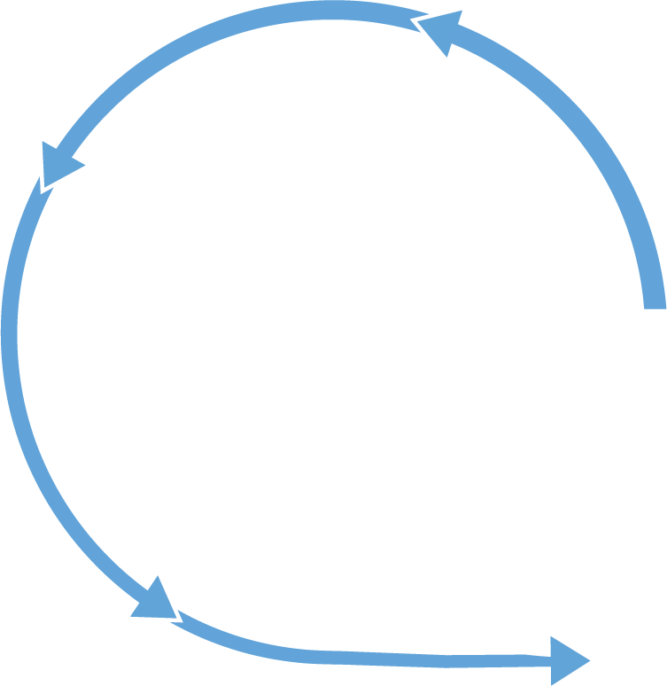
Why IDEAs in Action?
DISCOVER
Coherent & student focused
Navigation and equity
Alignment with UNC’s public mission and goals
Integrates multiple goals
Disciplinarily agnostic
Collect
Listen
Investigate
Observe
Experience
Understand
Notice
Consider
Synthesize
Communicate
IDENTIFY
EVALUATE
Create
Innovate
ACT
Notes:
My plan is to outline, briefly, the philosophy and structure of the proposed curriculum to facilitate a useful conversation here and to encourage Faculty Council to follow EPC's recommendation and adopt the curriculum proposal.
What should a curriculum do?
We like this model because:
<discipline agnostic>
<student-centered>
<educate the whole student to thrive in multiple post-college roles>
And it should do this for all students – those well prepared and less so, those committed to an academic path and those not, those from low-income families and first generation to attend college, and those not. All students should have the tools to make the most of the opportunities a great global public research university offers.

Slide 4
First Year Foundations
First Year Seminar/First Year Launch
Writing at the Research University
Ideas, Information, and Inquiry
College Thriving
Students are strongly encouraged to begin Global Language during their first year. Lifetime Fitness is often taken during the first year, but may be taken anytime during a student's career. Students are strongly encouraged to take their III during the first year but may defer it to their second year.

Slide 5
Focus Capacities
Aesthetic & Interpretive Analysis
Creative Expression, Practice & Production
Engagement with the Human Past
Ethical & Civic Values
Global Understanding & Engagement
Natural Scientific Investigation
Power, Difference & Inequality
Quantitative Reasoning
Ways of Knowing
One Focus Capacity class must carry an Empirical Investigation Lab

Slide 6
Integration & Reflection
Research & Discovery Experience
High-Impact Experience
Communication Beyond Carolina
Campus Life Experience

Slide 7
Thank you
Coordinating Committee
3 years, broad and serious engagement
Faculty Council, FEC, EPC, Ad Boards, DUSs, students, staff, community members, faculty
Notes:
Coordinating committee: Fouad Abd-el-Khalick, Daniel Anderson, Jaye Cable, Duane Deardorff, Kelly Hogan, Christian Lundberg, Viji Sathy, Adam Versenyi, and the incomparable Abigail Panter
Thanks too to Kevin Guskiewicz for entrusting us with facilitating this extraordinary process
Thanks to the hundreds of faculty, students, staff, administrators, and communiity members who have participated in manifold ways in the design
And thanks to you, Faculty Council members, as well as FEC, EPC, Ad Boards, DUSs, and more for your patience and input. And a special thanks to Nick Siedentop and others at the Office of Undergraduate Curricula for their remarkable work.

Slide 8
Next Steps
Collective rather than collected
College and University have committed to support departments and the curriculum
Implementation Team with faculty representation led by OUC
General Education Oversight Committee: Fall 2019
Continued Pilots: 2019-2021
Implementation: Fall 2021
Notes:
Express the collective, not just collected, ambition of the university. Organizational impediments to doing that; asking to be citizens of the university, not of discipline or department, and CC has been a great example.

Slide 9
Resolution 2019-7.
On Adopting a New General Education Curriculum.
The Faculty Council approves the IDEAs in Action Curriculum (version 5.0, April 2019) as the new general education curriculum for undergraduates at UNC-Chapel Hill, to be fully implemented by Fall 2021 if possible. The General Education Oversight Committee will be formed in fall 2019 to manage implementation and oversight of the curriculum.
Notes:
The IDEAs in Action curriculum is a great opportunity for us to put into practice the ideals of access, excellence, and public service we are all so proud of at Carolina. We look forward to talking more this afternoon and respectfully ask for your vote in favor of a bold, innovative, student-centered, curriculum that builds on the best we, the faculty, have to offer for our students.

