Slide 1
Curriculum 2019
Andrew J. Perrin and the
Curriculum 2019 Coordinating Committee

Slide 2
Curriculum 2019 Coordinating Committee
Fouad Abd-el-Khalik, Education
Daniel Anderson, English & Comparative Literature
Jaye Cable, Marine Sciences
Claude Clegg, African, African-American, and Diaspora Studies & History
Duane Deardorff, Physics & Astronomy
Kelly Hogan, Biology
Christian Lundberg, Communication
Viji Sathy, Psychology & Neuroscience
Adam Versenyi, Dramatic Art

Slide 4
Experience
Observe
Notice
Ask and frame questions
Generate claims and ideas
Experience
Observe
Notice
Ask and frame questions
Generate claims and ideas

Slide 5
Inquire
Investigate
Listen
Collect
Evaluate
Debate
Interpret
Analyze ideas and evidence
Inquire
Investigate
Listen
Collect
Experience
Observe
Notice
Ask and frame questions
Evaluate
Debate
Interpret
Generate claims and ideas
Analyze ideas and evidence

Slide 6
Inquire
Investigate
Listen
Collect
Evaluate
Debate
Interpret
Analyze ideas and evidence
Understand
Synthesize
Imagine
Understand
Synthesize
Imagine
Consider diverse perspectives
Make sound, ethical judgments within uncertainty and complexity
Generate new ideas and views
Inquire
Investigate
Listen
Collect
Consider diverse perspectives
Evaluate
Debate
Interpret
Make sound, ethical judgements within
uncertainty and complexity
Analyze ideas and evidence
Generate new ideas and views

Slide 7
Create
Communicate
Argue
Contribute
Convince
Innovate
Experiment
Intervene
Implement judgments
Create
Understand
Synthesize
Imagine
Communicate
Argue
Contribute
Convince
Experiment
Consider diverse perspectives
Innovate
Implement judgements
Make sound, ethical judgements within
uncertainty and complexity
Intervene
Generate new ideas and views
Understand
Synthesize
Imagine
Consider diverse perspectives
Make sound, ethical judgments within uncertainty and complexity
Generate new ideas and views

Slide 9
Capacities for Success
Evidence-Based Reasoning | Communication and Collaboration | Principled Engagement | Impact
Quantitative Analysis | Written communication | Ethics | Creativity
Qualitative Interpretation | Oral and Digital communication | Engagement with diverse cultures, ideas, viewpoints, and practices | Change
Inquiry | Effective listening | Empathy | Engagement
Judgment under uncertainty | Collaboration/Working with Others | Critical self-reflection | Leadership
Notes:
The key to preparing students to be effective, successful citizen-scholars is developing flexible capacities that are useful in many areas. Beyond specific skills—which are adapted to specific contexts—capacities are flexible and adaptable to different contexts, including new contexts that emerge.
The curriculum seeks to develop four groups of capacities that, as a group, will foster the kind of engagement envisioned in the citizen-scholar model. These groups overlap one another, and in practice they are closely connected. They are:
· Evidence-based reasoning: the tools and tendencies of gathering, understanding, interpreting, and assessing evidence;
· Communication and collaboration: presenting ideas and information effectively; listening to and understanding the ideas and claims of others; and working effectively with others. These are a necessary for employment, citizenship, and personal success. This capacity includes both successful reading, interpretation, and evaluation of texts, digital, and oral communication, and clear and effective writing and speaking that engages the reader and audience.
· Principled engagement: approaching decisions and situations ethically and with self-reflection, considering the broader and long-term implications. The world our graduates enter is increasingly complex and interconnected economically, socially, culturally, ecologically, and technologically. Carolina graduates need knowledge, understanding, and experience with diverse cultures, viewpoints, ideas, and practices to navigate and lead in these environments. That diversity includes racial, ethnic, cultural, political, and religious diversity within the United States as well as diversity on a global scale.
· Impact: making ideas and decisions effective through implementation.
9

Slide 10
Curriculum 2019 Innovations
Focus on the First Year
Emphasis on Inquiry, Evidence, and Judgment
Experiential Education: Access, Participation, Quality, Integration
Vertical Integration through the College Career
Communication, Collaboration, Reflection
Streamlined Distribution Requirements
Blue-Sky Advising and Career Focus
Assessment, Amendment, Continuous Improvement

Slide 11
Focus on the First Year
Orientation
First Semester
Second Semester
FYS
Ideas, Information, and Inquiry
ENGL 105
Selection of
FYS
Student Services: Advising, Life Skills, Career Services
Ideas, Information, and Inquiry
FYS
Direct tie
ENGL 105
Student Services: Advising, Life Skills, Career Services
Ordinarily tied but may be changed with reason

Slide 12
Ideas, Information, and Inquiry Course
Required for all first-year students
Large course, team-taught by faculty groups
The idea of a university as a place for active and dynamic inquiry, discovery, and innovation across all domains of human knowledge
Different kinds of, sources of, and approaches to, evidence and data
Diverse (locally and globally) understandings of what questions are asked, how they are asked, and what kind of evidence is brought to bear on them
Principles of interpretation (quantitative, qualitative, and interpretive) and threats to validity of such interpretations
Identification of faulty reasoning and bias (of all kinds) and appropriate conclusions from claims and information in media accounts.
Notes:
Fellows (specially-trained and participating faculty or advanced graduate students). In the big picture, this is a "how to argue" course, providing the foundations for understanding and interpreting evidence, forming claims and arguments, and listening and responding to others' claims and arguments. This course includes digital literacy, basic numeracy, data literacy, and critical/systematic inquiry. This course will address quantitative and qualitative data as typically gathered in natural and social scientific and humanities disciplines. The course will provide a grounding in key inquiry and evidence-based
reasoning skills that are crucial in every academic discipline and with all forms of evidence, including the analysis of qualitative and quantitative scientific data that has inherent limitations, as well as interpretive approaches associated with the arts and humanities. The III course will be coordinated
12

Slide 13
General Education Courses
Distribution | Focus
3 Humanities/Fine Arts (2 different units) | 1 US/Global Diversity
3 Social Sciences (2 different units) | 1 Ethical Reasoning
3 Natural Sciences/Mathematics (2 different units) | 1 Quantitative Reasoning
 | 1 Research-Intensive
Foreign Language to Level 3
Lifetime Fitness, Mental Health & Wellness, Life Skills

Slide 14
General Education Courses - Criteria
Cover substantive content representing a significant field, subfield, or topic consistent with the department or unit offering the course;
Provide sufficient diversity of ideas, approaches, viewpoints, and frameworks to allow students to evaluate and judge among the legitimate debates in the field;
Be challenging and rigorous;
Engage students in the active processes of inquiry, evidence, and discovery appropriate to the field;
Represent significant methodological, substantive, and/or theoretical approach(es) common to the Division for which the course counts;
Foster creativity, judgment, and sound conclusions under ambiguity and uncertainty using the evidence and analytic traditions of the field;
Include substantial written, digital, and oral communication;
Require collaboration; and
Be taught using instructional techniques based on evidence about student learning appropriate to the field.

Slide 15
Experiential & Co-Curricular Education
High-Impact Experiences (Internships, Study Abroad, Mentored Research, Creativity/Making)
Community-Based Learning (Service Learning, Social Innovation)
Connection to Academic Work
Campus Environment

Slide 16
Vertical Integration
e-Portfolios/Self-Curation
General and Supplemental Education alongside Majors
Junior/Senior Communication and Integration Course
Integrated Advising and Career Planning Throughout

Slide 17
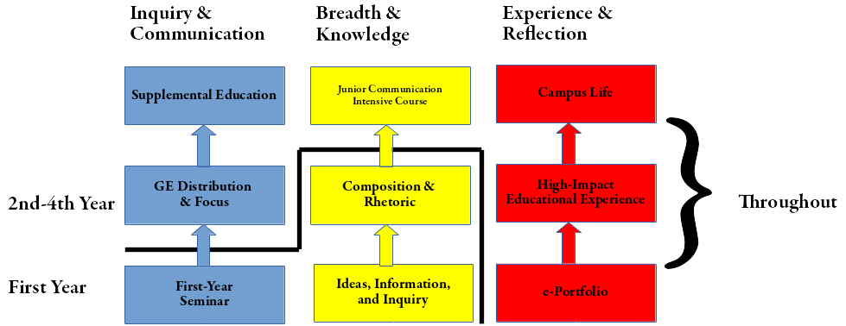
Capacity Tracks

Slide 18
Timeline
September 8 – Unveil at Faculty Council
Fall 2017 – Public discussion, detail committees
January 2018 – Faculty Council adoption
February 2018-August 2019 – Implementation, Resourcing, Documentation
August 2019 – Rollout for Class of 2023

Slide 19
Comments, Thoughts, Ideas, Concerns
curriculum2019@unc.edu
http://curriculum2019.web.unc.edu

