Slide 1
Center For Faculty Excellence: Leadership and Faculty Development
Erin Malloy, MD
Director, Center for Faculty Excellence
June Merlino
CFE Leadership and Faculty Development Coordinator
April 2017

Slide 3
Summer Writing Groups
Orientation May 5
Accountability Group Model
Tailored to Interest, Structure
Sign Up Now!

Slide 4
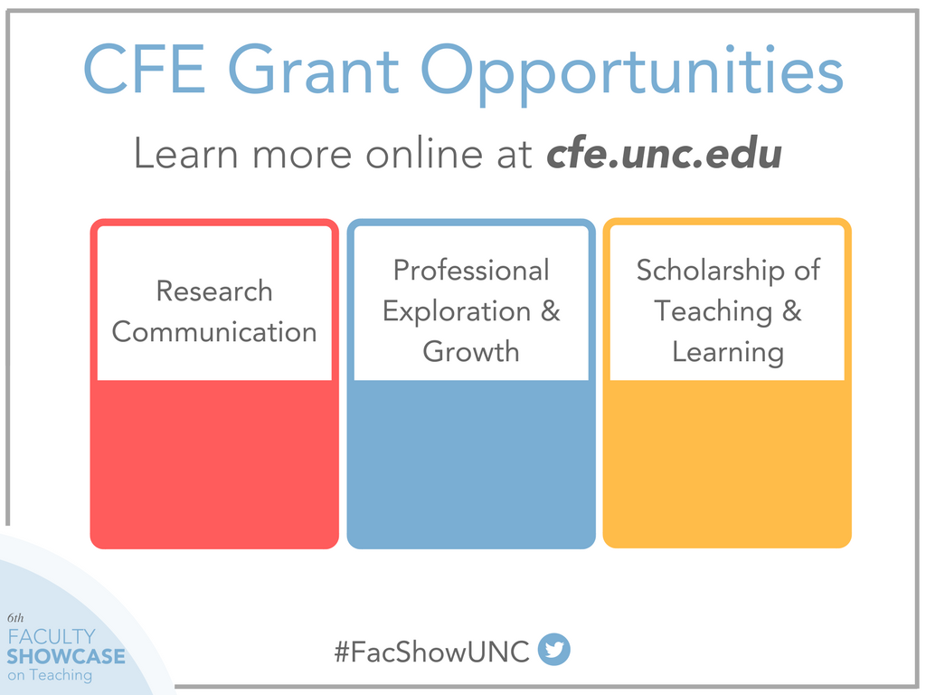

Slide 6
Center For Faculty Excellence Leadership and Faculty Development
June Merlino
CFE Leadership and Faculty Development Coordinator
April 2017

Slide 7
Academic Faculty Roles Fostering Relationships
Academic Excellence
and
Scholarly Application
Faculty
Chair
Dean
Provost
Chancellor
Colleagues and Staff
Students
Public

Slide 8
Faculty Roles and Leadership Skills
Discovery and Definitions
You as Faculty Session #1 - Your Role: Professional and Leadership Skills
Teaching and Learning
When facilitating teaching and learning, what interpersonal skills are needed to be effective (model) with students ?
Leading Research Teams
When leading a research team or as member of the team, what kinds of skills are important to be collaborative?
Service
When leading university committees, task forces and participating in faculty departmental meetings, what skills are necessary to build relationships, manage meetings and ensure outcomes?
Model the Way

Slide 9
Vision Leadership and Faculty Development
Outcomes
Academic Leaders
Faculty
Students
External
Groups
Organizations
World
Mission
Leadership Skills & Behaviors
Building a Culture of Leadership
Meaning

Slide 10
CFE Leadership and Faculty Development
CFE Leadership and Faculty Development – Vision
Be known and recognized as an innovator for leadership development in the higher education community. Create a continuous and deliberate ‘culture for leadership’ where all faculty and academic leaders model, mentor and motivate students, colleagues, leaders and other key collaborators to lead with passion, collaboration and shared commitment to our mission and values.
Strategic Goal #1 – Leadership Culture
Create and cultivate a culture of academic leadership
Strategic Goal #2 – Leadership Learning Framework
Create and implement a leadership development-learning framework for levels of leaders and faculty
Strategic Goal #3-Leadership Development Technology
Develop and implement learning technology options to enhance leadership-programming options
Strategic Goal #4-Leadership Development Creativity and Innovation
Cultivate ongoing opportunities for creative innovation regarding leadership programming, development options and engaging leaders and faculty to achieve continuous improvement

Slide 11
Faculty Leadership Development Learning Program Tracks – All Faculty (Sample)
You: Faculty/Professional Role and Skills | Leading and Cultivating Relationships with Others | You as Faculty in the University
Roles of Faculty Discovery and Definitions: In what ways does your role as Faculty (teaching and learning, research teams and service commitments) require professional and leadership skills? Create an Individual Faculty Development Plan and Career Goals Understanding Your Strengths & Communications Style | Listening to Understand Giving & Receiving Feedback Managing Conflict Effectively Mentoring for Success Fostering Collaborative Departments/Units and Teams Meeting Planning, Facilitation and Management Managing Your Time Effectively Diversity and Inclusion | Understanding Strategy in Higher Education

Slide 12
CFE – Academic Leadership Development June Merlino, Leadership and Faculty Development Coordinator
Academic Leaders | Audience
New Leaders (Two Programs) Leadership Fundamentals | Current or Newly Appointed Academic Leaders Cohort Program – Nomination Process by Deans and Chairs Self-nomination with recommendation by Deans/Chairs
Faculty Administrators Development Program (FADP | Current or Newly Appointed Leaders Cohort Program – Nomination Process by Deans
Experienced Leaders (Two Programs) Leadership Advanced | Experienced Leaders with Two or More Years Cohort Program – Nomination Process by Deans and Chairs Self-nomination with recommendation by Deans/Chairs
FLC – Strategy and Leadership | Experienced Leaders with Two or More Years Cohort Program – Nomination by Deans
Chairs Leadership Skills Series | Current or Newly Appointed Chairs Open Enrollment
Leadership Series Targeted Seminars Open Enrollment | Open program for any level of academic leaders or highly interested emerging leaders

Slide 13
Next Steps and Timeline
Communicate
April/May 2017
Recruit
May/June 2017
Launch Programs
Fall 2017

Slide 14
Questions and Comments
Thank You!

Slide 15
CFE – Faculty Leadership Development June Merlino, Leadership and Faculty Development Coordinator
Faculty Core Leadership and Professional Skills | Audience | Program Overview | Curriculum Highlights
New and Early Career Faculty Leadership and Professional Core Skills and Fundamentals Open Enrollment | Faculty starting in academic roles, including tenure-track, non-tenure track, fixed term contract, adjunct. | Career Planning and professional skills necessary for faculty roles in collaboration and relationship building with colleagues, staff, students and others. Discovery and Definitions You as a New Faculty Session #1 Orientation and Defining Your Role and the Intersections with Professional and Leadership Skills Faculty Roles and Questions How does your role as Faculty in Teaching and Learning require professional and ‘leadership’ skills for modeling effective facilitation and demonstrating interpersonal skills? (Apply to Research and Service Roles) | 2 – Core Areas Career Planning: Begin to identify, plan and chart your career pathway for professional learning and goals Create IDP for Teaching, Research and Leadership Determine and Identify Mentoring and Coaching Resources Core Leadership and Professional Skills You and Your Role: how leading with professional skills support faculty success. Defining Opportunities in the Academy as a new Faculty member Selected Topic Seminars and Mentoring/Coaching Groups
Mid-Career Faculty Open Enrollment | Faculty who just completed the tenure process or preparing for tenure review. Faculty non-tenure track and experienced. | Career Renewal and professional skills Discovery and Definitions You as a Mid-Career Faculty Session #1 (same as new faculty) | 2 – Core Areas Career Renewal: Refresh and renew career direction, post tenure appointment, prior tenure and non-tenure track.
Senior Faculty Open Enrollment | Experienced faculty (tenure or non-tenured) | Career Renewal and professional skills Discovery and Definitions You as a Senior Career Faculty Session #1 (same as new faculty) | 2 – Core Areas Career Renewal: Determine next opportunities for career renewal and interests Discover opportunities for mentoring and coaching
Graduate Students | Graduate students and post-docs Collaborate and partner with Graduate School | Career Planning and professional skills for collaboration and relationship building | Core Areas Career Planning: (same as New Faculty) Planning for Future Faculty Role

Slide 16
CFE – Academic Leadership Development June Merlino, Leadership and Faculty Development Coordinator
Academic Leaders | Audience | Program Overview | Curriculum Highlights
New Leaders (Two Programs) Leadership Fundamentals | Current or Newly Appointed Academic Leaders Cohort Program – Nomination Process by Deans and Chairs Self-nomination with recommendation by Deans/Chairs. | Comprehensive leadership program focused on key leadership assessments, topics and cohort structure for skill development, shared learning and relationship building. Complete an Individual Leadership Development Plan | 3 – Core Areas You as a Leader: Role and Self-Assessments You and Leading Others: Building Relationships Skills You and the University: Understanding Strategy and Leading Change in Higher Ed
Faculty Administrators Development Program (FADP | Current or Newly Appointed Leaders Cohort Program – Nomination Process by Deans | Extensive introduction and overview to UNC Administrative Groups and Services Sakai Site with Administrative Groups Information | Presentation Format – Administrative Groups 12 – 1.5 Hour Monthly Sessions Lunch Provided
Experienced Leaders (Two Programs) Leadership Advanced | Experienced Leaders with Two or More Years Cohort Program – Nomination Process by Deans and Chairs Self-nomination with recommendation by Deans/Chairs | (Parallel to New Leader program and focused on advanced practices) | 3 – Core Areas (Parallel to Leadership Fundamentals)
FLC – Strategy and Leadership | Experienced Leaders with Two or More Years Cohort Program – Nomination by Deans | Extensive program for experienced leaders creating and leading new strategies and innovation. UNC Expert Facilitators (Internal and External) | Strategy Focus: Definition, Planning, Engagement and Implementation 10 – Two and ½ hour Monthly Sessions Leading Change Series – Leadership Skills (TBD)
Chairs Leadership Skills Series | Current or Newly Appointed Chairs Open Enrollment | Chair Leadership Skills Series: determine key leadership skills using Leadership Architect. Targeted skill development to build mastery, lead and serve as mentor/model. | 2 – Core Areas You as Leader: Identifying Key Chair Leadership Competencies. You and Leading Others: Selected Skills Series
Leadership Series Targeted Seminars Open Enrollment | Open program for any level of academic leaders or highly interested emerging leaders | Basic introduction to foundational leadership concepts, models, skills and practice | Targeted and Selected Skills Series Creation of Individual Leadership Development Plan

