Slide 1
Faculty Retention & Recruitment Update
for Tenured & Tenure-Track Faculty
Analysis of Recent Data (7/1/2015 – 6/30/2016)
& Comparison with Previous Years

Slide 2
What are the primary metrics?
How many tenured or tenure track faculty members received external offers?
What percentage of our counter-offers were successful in retaining faculty with offers?
How many tenure and tenure-track faculty does UNC recruit from other universities?

Slide 3
Numbers of External Offers for Tenured/T-T Faculty
2002-2003: 75
2003-2004: 69
2004-2005: 32
2005-2006: 48
2006-2007: 58
2007-2008: 26
2009-2010: 87
2010-2011: 110
2011-2012: 78
2012-2013: 76
2013-2014: 56
2014-2015: 53
2015-2016: 53

Slide 4
External Offers made to our Tenured/T-T Faculty
Breakdown of the 53 External Offers made:
28 CAS
8 SoM
5 SoPH
3 SoEd
3 KFBS
2 SoL
1 SoG
1 SoMJ
1 SoN
1 SoP

Slide 5
Major competitors – Making more than 2 external tenure or tenure track offers to UNC faculty
2011-2012: 2013-2014:
Vanderbilt (5 offers) Duke (3 offers)
Duke (4 offers) Pittsburgh (3 offers)
Miami (3 offers) U of Washington (4 offers)
Pittsburgh (3 offers)
Ohio State (3 offers) 2014-2015:
Arizona State (2 offers)
2012-2013: Duke (2 offers)
Duke (4 offers) Ohio State (2 offers)
Vanderbilt (4 offers) Penn State (2 offers)
Ohio State (4 offers) Colorado-Boulder (2 offers)
South Carolina (3 offers) U of Texas (3 offers)
NCSU (3 offers) U of Washington (4 offers)
2015-2016:
Duke (5 offers)
Emory University (2 offers)
European University Institute (2 offers)
University of Kentucky (2 offers)
University of Zurich (2 offers)

Slide 6
How many tenured and tenure-track faculty did we lose to external offers?
In 2007-2008, we lost 33 faculty, 8 due to failed retentions.
In 2009-2010, we lost 58 faculty, 29 due to failed retentions.
In 2010-2011, we lost 78 faculty, 46 due to failed retentions.
In 2011-2012, we lost 35 faculty, including 10 due to failed retentions.
In 2012-2013, we lost 48 faculty, including 15 due to failed retentions.
In 2013-2014, we lost 20 faculty, including 8 due to failed retentions.
In 2014-2015, we lost 16 faculty, including 6 due to failed retentions.
In 2015-2016, we lost 11 faculty, including 3 due to failed retentions.
A failed retention is a faculty member who got a counter offer and left anyway.

Slide 7
Which UNC Schools suffered a loss due to External Offers?
In 2015-2016, we lost 11 faculty, including 3 due to failed retentions:
9 CAS (includes the 3 due to failed retentions)
1 SoM
1 SoPH

Slide 8
Retention Success Rates for Tenured/T-T Faculty (stayed/total external offers in %)
2002-2003: 30%
2003-2004: 62%
2004-2005: 68%
2005-2006: 53%
2006-2007: 72%
2007-2008: 69%
2009-2010: 50%
2010-2011: 61%
2011-2012: 69%
2012-2013: 37%
2013-2014: 64%
2014-2015: 68%
2015-2016: 79%

Slide 9
Counter Offers
Of the 53 who got external offers this year, UNC gave 39 (39/53 = 74%) of them counter offers.
Of those 39 we gave counter offers to, 36 (36/39 = 92%) decided to remain at UNC, and 3 left anyway.
3 decided to stay even with no counter offer.

Slide 10
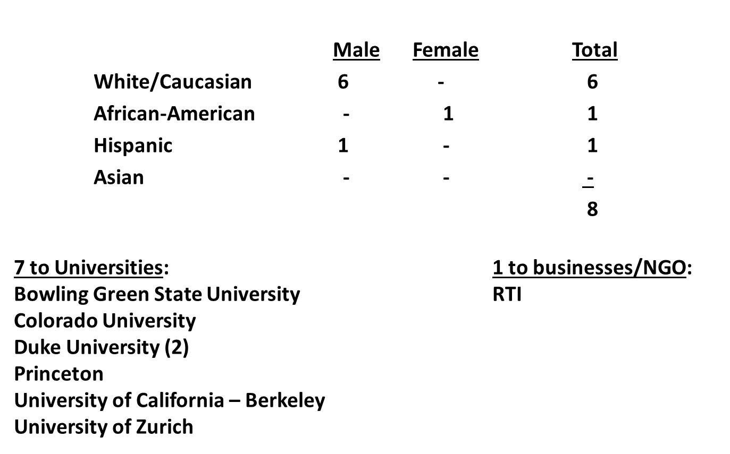
UNC lost 8 Tenured Faculty July 1, 2015 – June 30, 2016

Slide 11
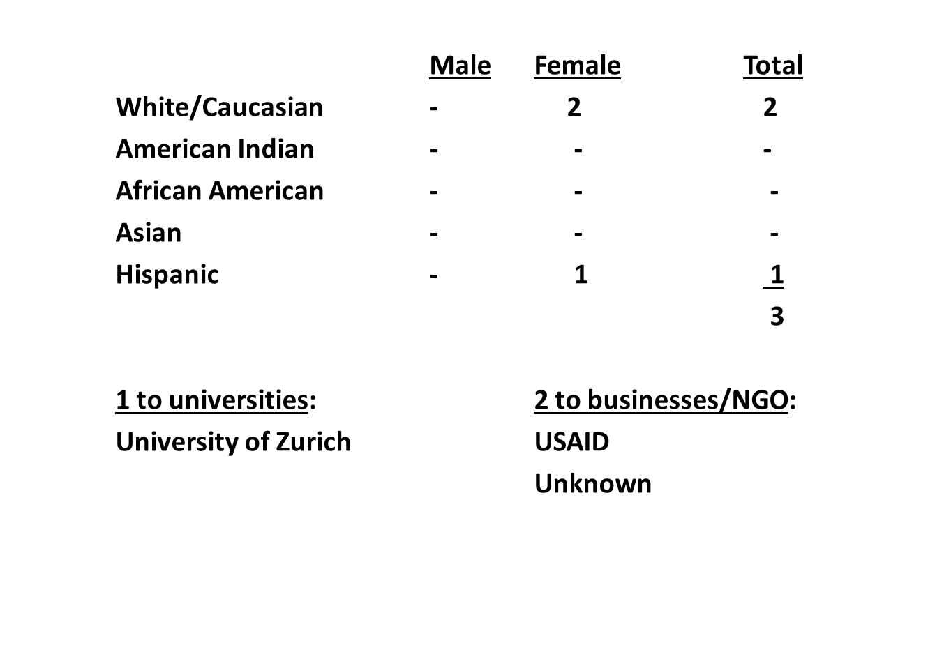
UNC Lost 3 Tenure-Track Faculty July 1, 2015 – June 30, 2016

Slide 12
7/2015 - 6/2016
94 FACULTY WERE RECRUITED TO UNC WHO ARE TENURED (18) AND TENURE-TRACK FACULTY (76)

Slide 13
Cost of Retentions of UNC Tenured & Tenure-Track Faculty 7/1/2015 – 6/30/2016
$271,300 from Provost funds to retain 8 faculty in Health Affairs
$130,166 from Provost funds to retain 12 faculty in Academic Affairs
We requested $119,793 from General Administration in our efforts to retain 6 of our faculty, of which they agreed to fund $102,449
$10,000 for 1 Health Affairs faculty
$92,449 for 5 Academic Affairs faculty
Combined funds totaled $503,915 for retention support

Slide 14
Retention and Recruitment Lessons
UNC exists within a competitive academic market
External offers to our faculty were down over previous years
When faculty members get raises or pre-emptive retentions, they generate fewer external offers
Counter offers work and are often successful in retaining faculty members with external offers
Carolina actively hires tenured and tenure track faculty from other universities
Annual tracking of retentions and recruitments is necessary to take the pulse of UNC’s faculty

