Slide 1
Financial Aid & Student Diversity
Donald T. Hornstein
Aubrey L. Brooks Professor of Law Chair of the Committee on Scholarships, Awards, and Student Aid
February 2016

Slide 2
How Does the Work of the Office of Scholarships and Student Aid Further Diversity at Carolina?

Slide 3
Carolina – Proudly Public
Carolina remains proudly public after 222 years – created by and for the people of North Carolina
Carolina remains a public asset, held in trust for the public good
We are custodians of that trust, employing need-based aid as a primary means of fulfilling our mission

Slide 4
Financial Aid Furthers Access, Excellence and Diversity
Admission to the University is "need-blind" — admissions decisions are not based upon a family’s ability to pay
Carolina admits those students who we believe can best help us achieve our mission, reflecting the practice of top-tier universities nationally
These practices, coupled with a robust program of both merit and need-based aid, further diversity
A diverse student body benefits the University as a whole, and improves the quality of education for all students

Slide 5
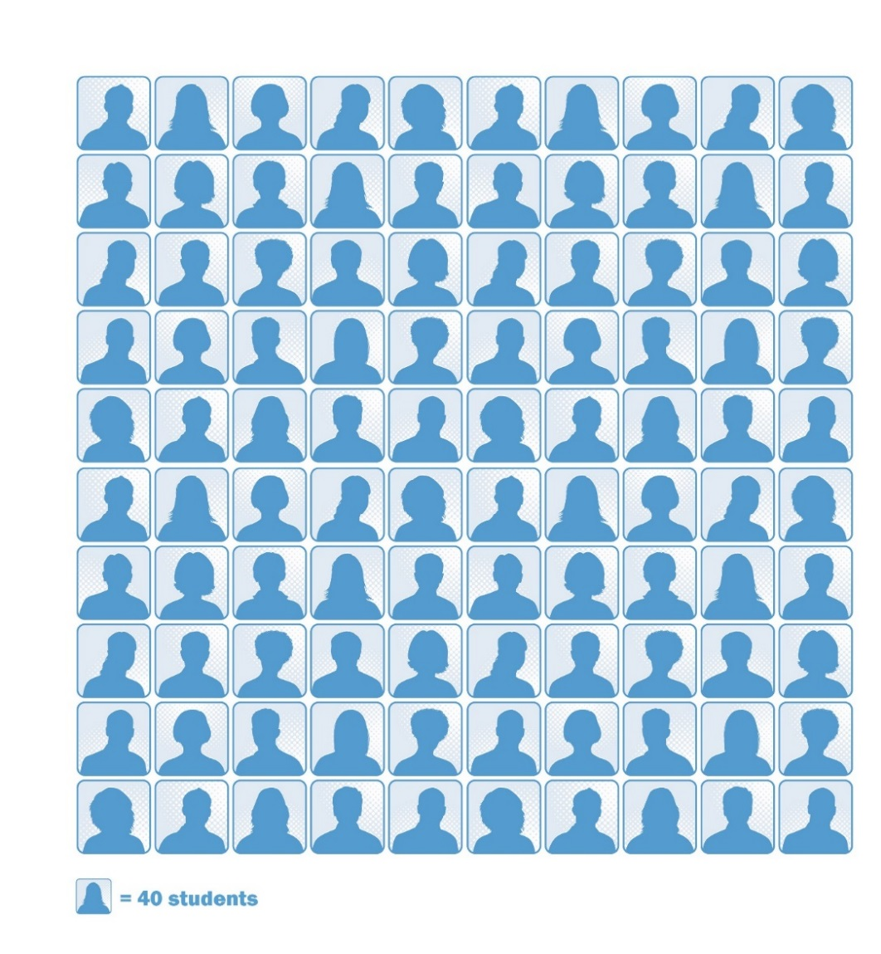
Fall 2014 Enrolling First-Year Class
78%
Top 10 Percent of Class
42%
Top 10 Rank in Class
14%
Valedictorians/Salutatorians
1318 - 1320
Average SAT
18%
First-Generation College
20%
Underrepresented Minority

Slide 6
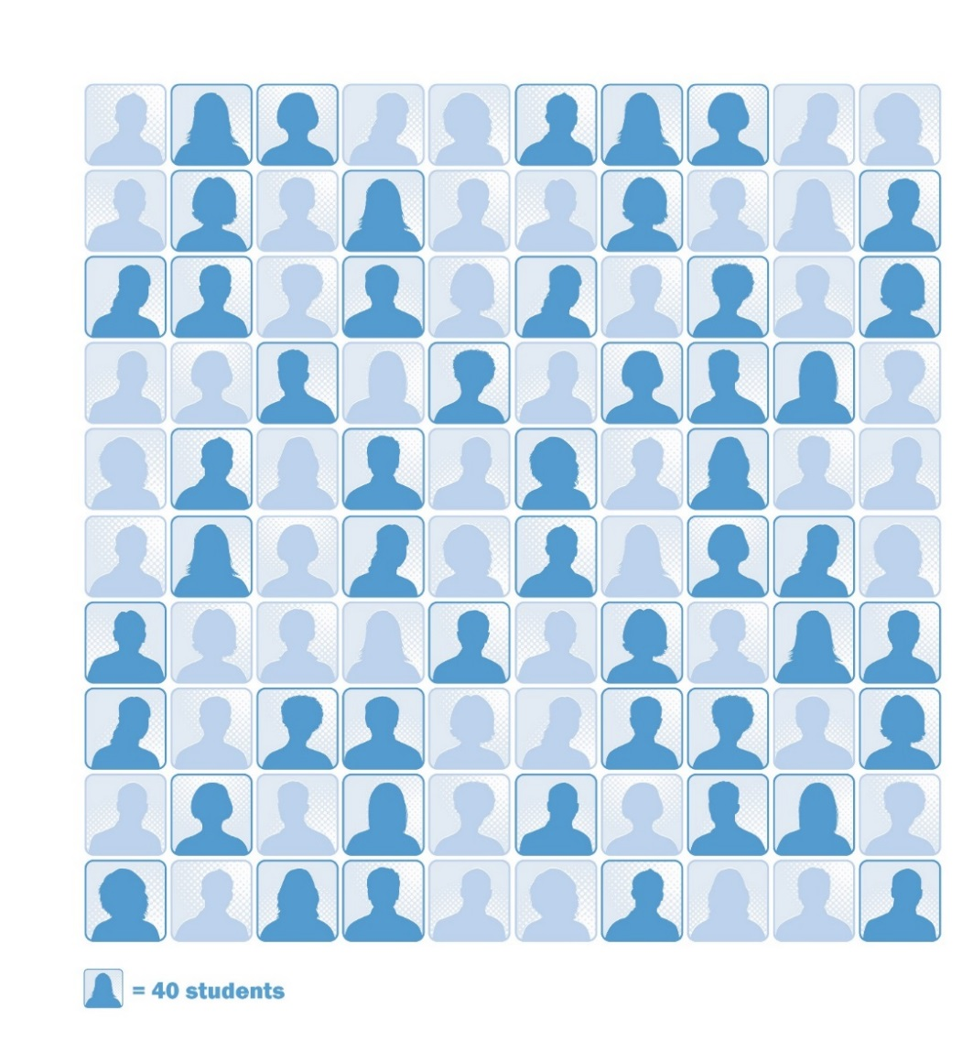
A First-Year Class Without Aid
78% 61%
Top 10 Percent of Class
42% 28%
Top 10 Rank in Class
14% 9%
Valedictorians/Salutatorians
1318 - 1320
Average SAT
18% 9%
First-Generation College
20% 9%
Underrepresented Minority

Slide 7
“If an elite school… insisted on admitting only students willing to pay the full freight, they would soon find they weren’t so elite.”
— Adam Davidson, Economics Reporter
September 18, 2015

Slide 8
Carolina -- Hallmarks of Diversity
Fall 2015 Undergraduates

Slide 9
Family Income Ranges
by Population (2014-15)
Median family income of aided students with need: $51,004
Carolina Covenant eligibility (200% federal poverty level or below) - Poverty level (for a family of four) in 2015: $24,250 - 200% of federal poverty: $48,500
Median family income of Covenant Scholars: $26,777
Median family income of first-generation students: $37,220
Median family income for all African-American undergraduates: $37,928

Slide 10
Under-represented Students are More Likely to Qualify for Need-based Aid

Slide 11
African-American Students Demonstrate Need at Much Higher Rate
Need Status Among 2015 Undergrads

Slide 12
Poverty Rates in North Carolina, by Race - 2013

Slide 13
Why Aid Matters
Financial aid provides access, but also furthers student engagement and excellence:
Financially aided students at Carolina participate equally in study abroad (on par with their more affluent peers)
Financially aided students explore world-class performances at reduced or no cost, compliments of our partnership with Carolina Performing Arts

Slide 14
Without financial aid, UNC would be much less diverse, and as a result the quality of the education we offer to all students would be compromised.
Why Aid Matters

Slide 15
Without financial aid, UNC would be much less reflective of the people of the state that it is meant to serve – much less “the University of the people”.
The “People’s University”

