Slide 1
Report on working conditions for Fixed-Term Faculty of color
November 13, 2015
UNC Faculty Council

Slide 2
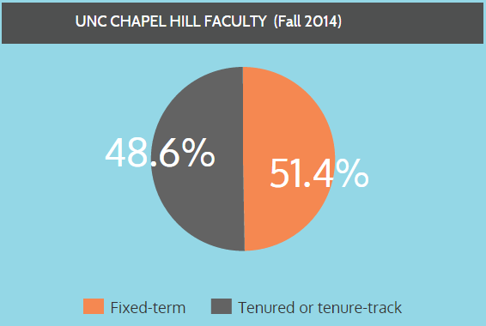
*
* Includes part-time Fixed-Term Faculty

Slide 3
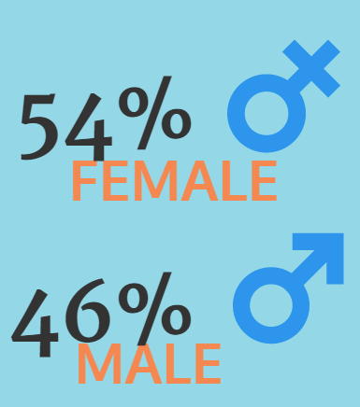
Compared with 44% Female for the total faculty

Slide 4
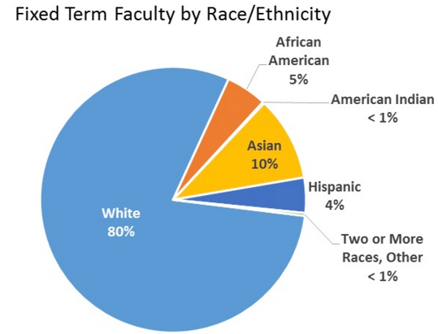

Slide 5
In the Summer 2014, the Committee no Fixed-Term Faculty conducted a survey of Fixed-Term Faculty who did not hold adjunct appointments.
Minority respondents reported concerns in the following areas:
Compensation
Job Security / Contract Length
Parity with Tenure/Tenure Track colleagues
Clarity of Promotion Criteria
Valuation
Workload
Resources
Funding opportunities
Training/Development opportunities
Access to mentors

Slide 6
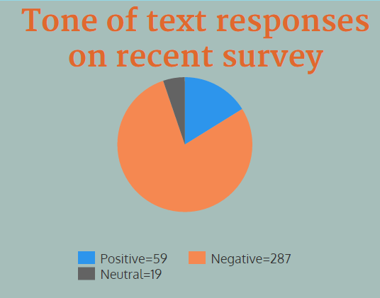

Slide 7
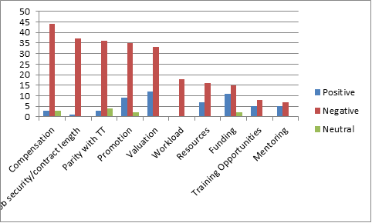
Frequency of responses of Minority Fixed-Term Faculty on various professional challenges

Slide 8
Representative text responses from UNC Minority Fixed-Term Faculty:
“I currently have a one-year, full-time contract but I have been here for over 30 years!”
“In the current system, a fixed-term faculty is destined to spend the entire career at UNC without any job security, regardless of the significant contributions made to the University!’
“I still find the promotion and review process difficult to navigate, as well as opportunities for negotiation and advancement in this position.”
“If salary cannot be comparable to tenured/tenure-track professors then having at least a comparable title and privileges/rights (e.g. eligibility for sabbatical, awards, etc) would be satisfactory.”

Slide 9
Added to Fixed-Term Faculty ‘Best Practices’ recommendations:
Because career development is heavily influenced by climate, departments should encourage open communication about professional roles and expectations, including sensitivity to differences based on race, gender identity/expression, family status, class, geography, age, sexual orientation, and other protected categories of identity.

Slide 10
Professional development and leadership opportunities
When requested, professional development opportunities should be made available to fixed-term faculty.
Leadership opportunities including departmental and university-wide service should be considered.

Slide 11
Thanks to:
Bruce Cairns, Chair of the Faculty
Sarah Birken – Health Policy and Management
Katie Turner – Faculty Programs Specialist
Anne Whisnant – Deputy Secretary of the Faculty
Rumay Alexander – Chair, Diversity and Community
Wayne Blair – University Ombuds
Committee for Fixed-Term Faculty (2014/2015 and current committee)

