Slide 1
The
Research
Hub
AT UNC LIBRARIES

Slide 2
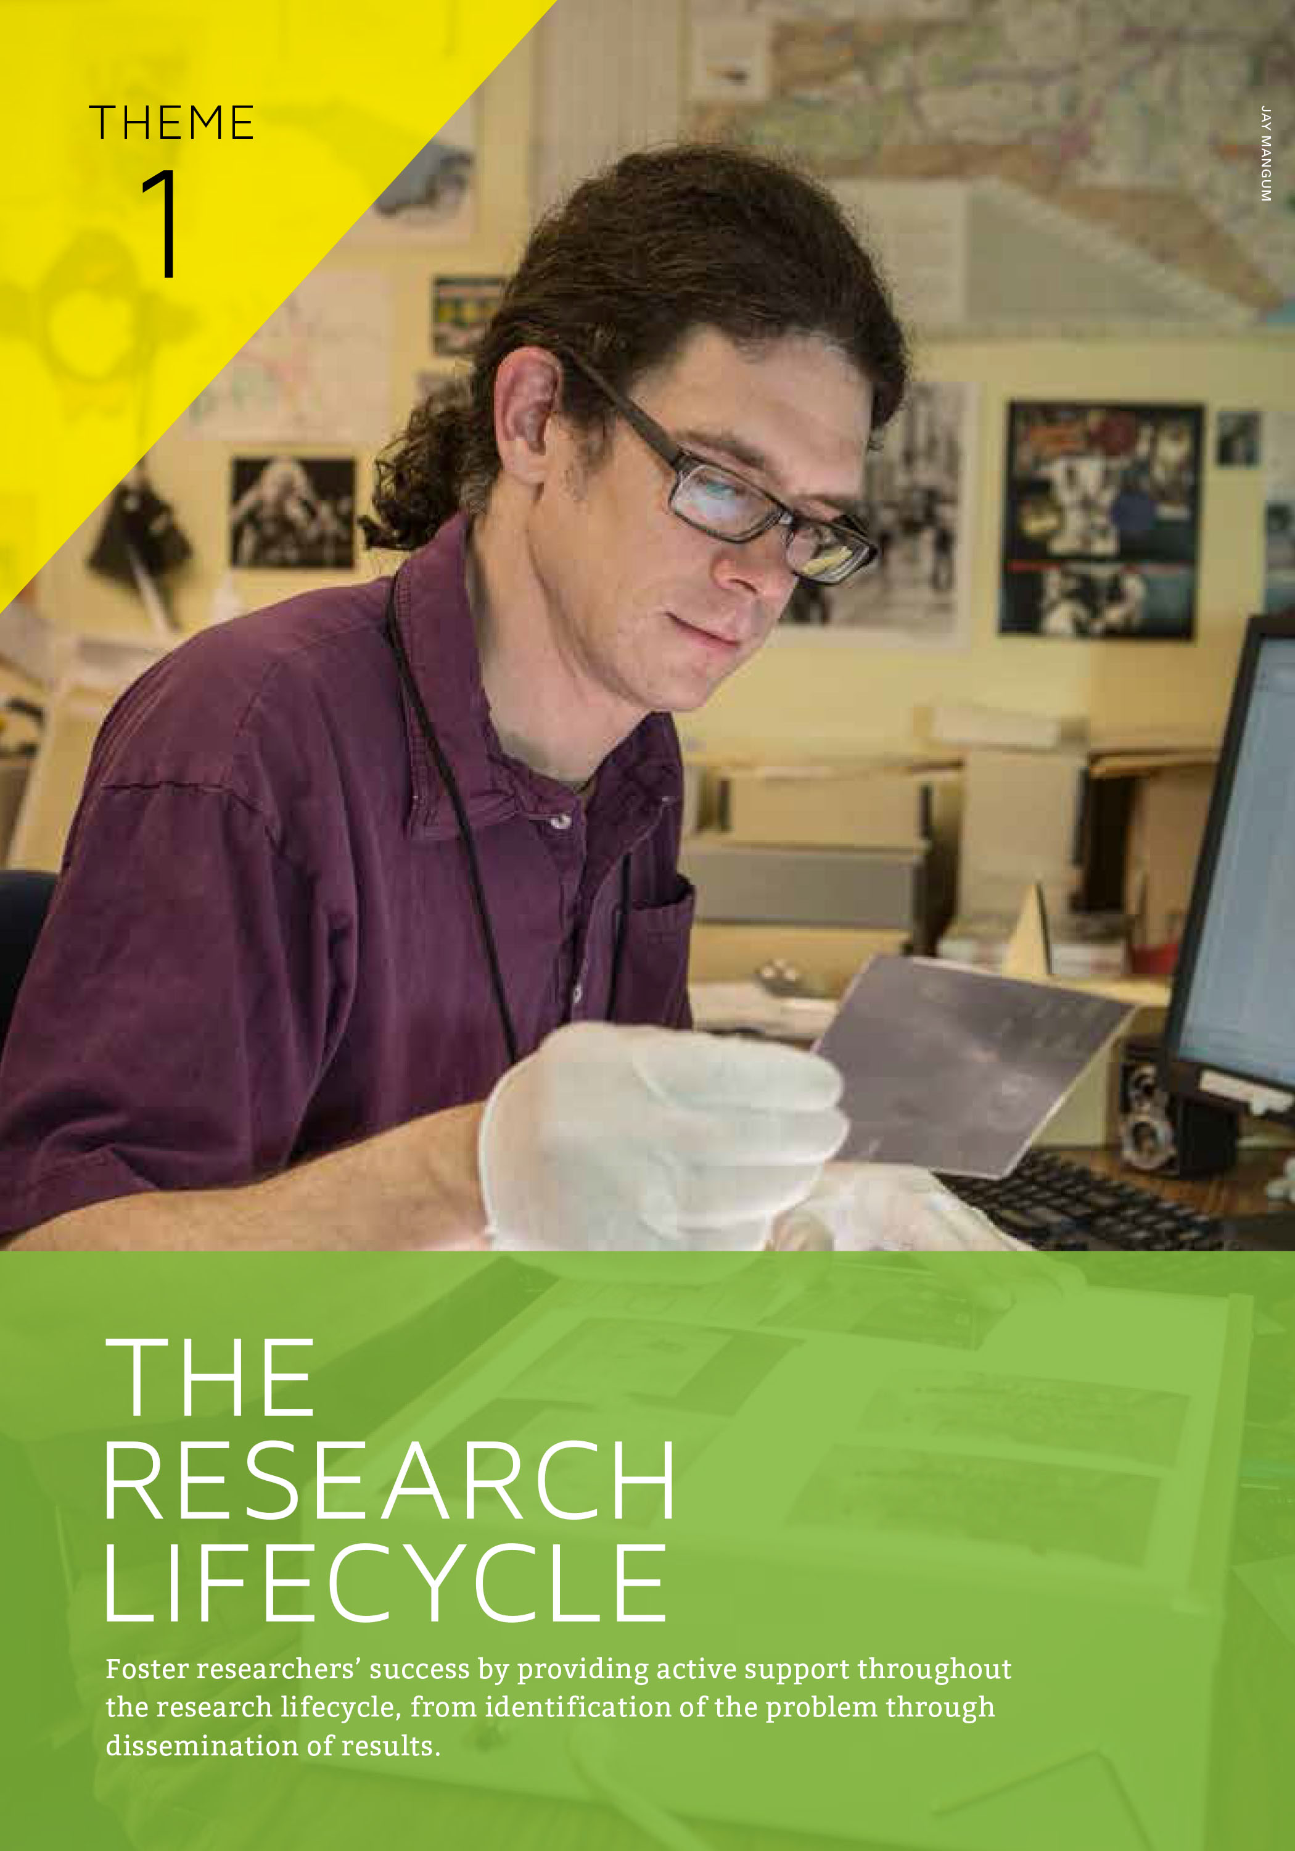
Foster researcher success by providing active support throughout the research lifecycle
Notes:
In 2013 – after more than a year of research, faculty and student interviews, and focused planning -- the UNC University Libraries completed and published a new 5-year strategic plan.
One of the first planning efforts to grow out of the plan was the research commons planning committee. we were charged with developing a plan to continue the transformation of the library into a hub for knowledge, expertise, and services that are valued by the campus community and the people of the state.
Foster researcher success by providing active support throughout the research lifecycle--from identification of the problem through dissemination of results.
Provide strong collections and develop new mechanisms for delivering them to researchers
Provide researchers with the space, tools, and information assistance they need to successfully conduct research and manage research results.
Support the dissemination and preservation of research results and the measurement of their impact

Slide 3
Connects students and faculty to services, tools, programming, and technology to support research. Provides spaces for collaboration, shares and highlights research and creative output, and engages scholars.
Notes:
In pursuit of this goal, the Libraries are investing in a program that will support both traditional and digital research services across disciplines; we refer to that program as “the Research Hub.”
The Hub is a combination of physical and virtual spaces maintained by the Libraries in collaboration with key partners, including the Odum Institute, the Center for Faculty Excellence, NC TraCS, Carolina Health Informatics
Promotes tools and services, shares and highlights research and creative output, engages scholars, and unifies the Library’s physical and virtual resources.

Slide 4
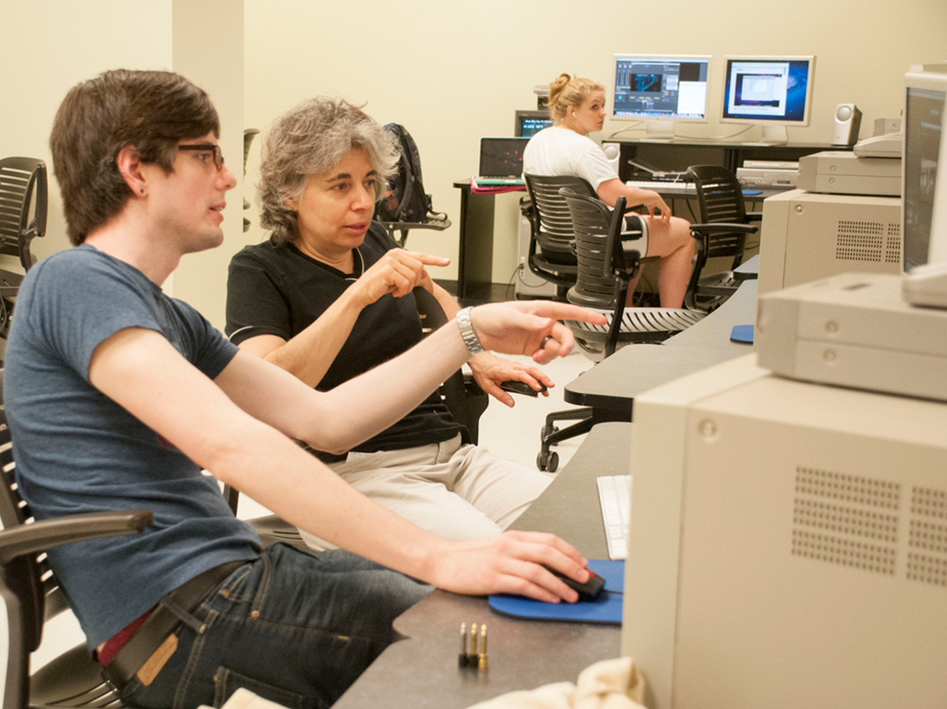
Core features
Skilled staff to support research
Spaces for consultation, creation, and presentation
Cutting-edge technologies, with training and support
Events that showcase faculty and student research, and provide opportunities for interdisciplinary research
Notes:
The Hub will provide:
Skilled librarians, technology specialists, and other expert staff to support your work;
Spaces to work in, and spaces for engagement;
Cutting-edge technologies, along with the training and support to use them;
Events that showcase the research activities of faculty and students; A diverse calendar of events and programming attracts users and will establish and sustain a creative and engaging culture.
Opportunities for colleagues across and beyond campus to connect with one another.

Slide 5
Points of engagement
Davis Library
Kenan Science Library
Health Sciences Library
Notes:
There are three physical points of engagement across campus, located in three different libraries and offering services tailored to their respective patrons. Programs and events at one location will be viewable from other locations and on the web.

Slide 6
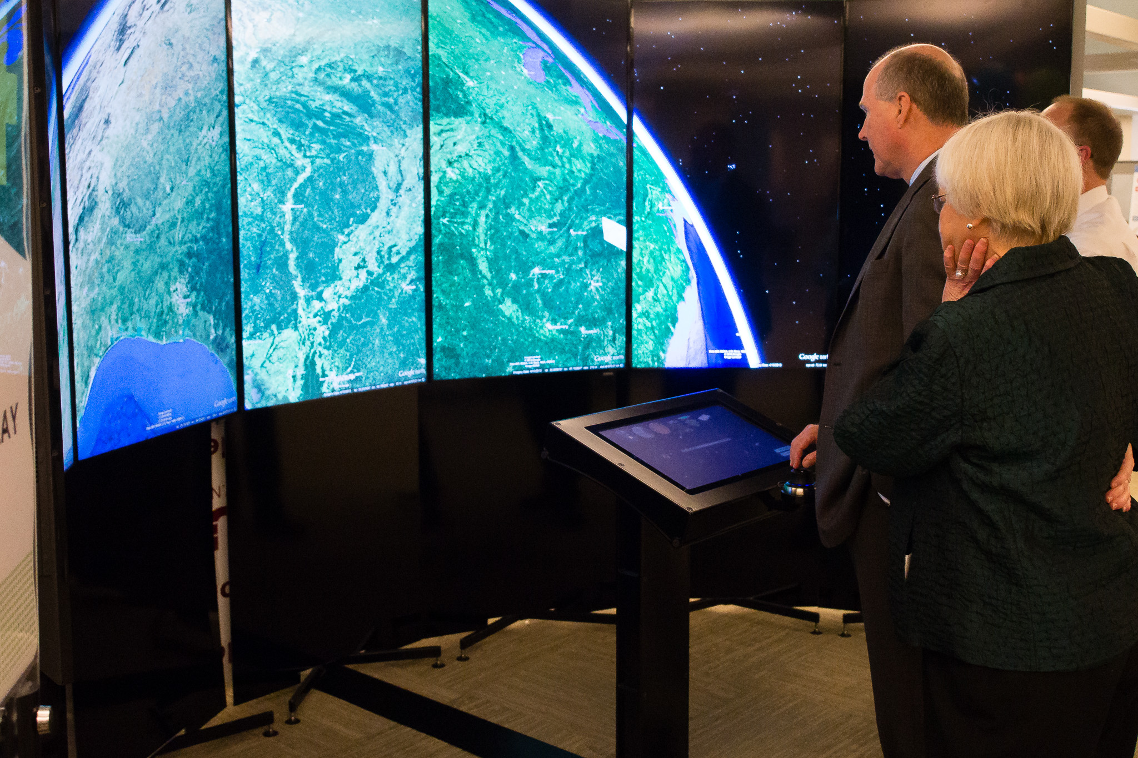
Davis Library Research Hub
Notes:
Collaborative, bookable work spaces
Presentation space
GIS/Stats Open Lab—hardware and software to support these areas
Liquid Galaxy
Provide low-barrier access to a wide range of technologies with the potential to transform teaching and learning and advance new forms of scholarship.

Slide 7
Davis Library Hub Services
GIS services
Numeric data services
Data analysis
Data visualization
Data management
Data curation
Digital humanities consulting
Notes:
Discovery/use of information resources
Planning/design/funding research activities
GIS services
Data collection
Data analysis
Data management
Data visualization
Data curation (CDR and Odum dataverse locally, referrals to discipline-specific repos)
Digital scholarship
Copyright consulting
Digital humanities
Reputation management
Omeka for digital exhibits
Integrating research methods into instruction
on-demand consultations
consultation by appointment
public programming
guided training
referrals to campus services

Slide 8
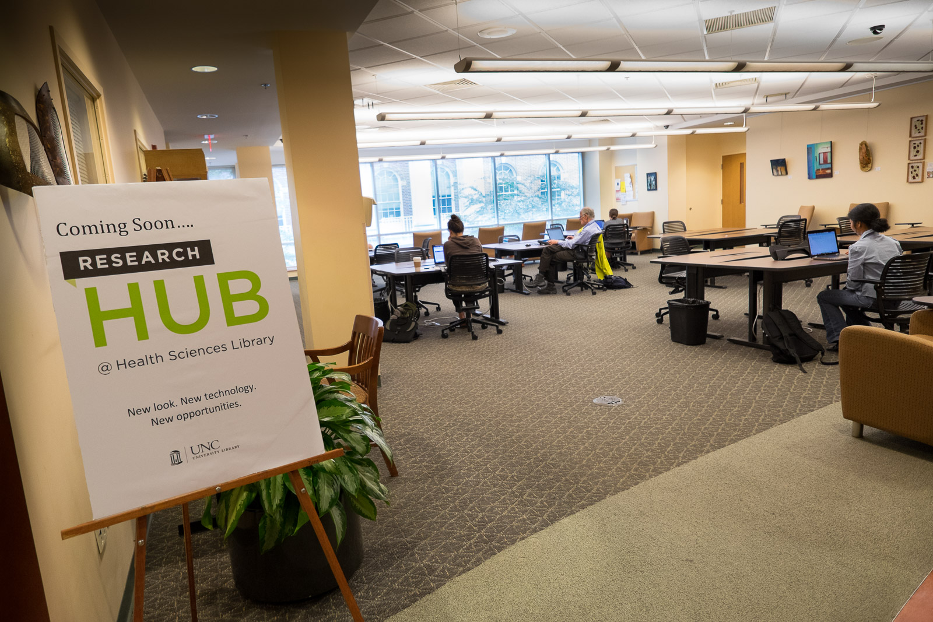
Health Sciences
Notes:
Collaborative work spaces
Space for instruction and presentation
Distance education and point to point videoconferencing
Multipoint videoconferencing
In the Health Sciences Library, teleconferencing facilities connect health care professionals around the state and around the world. Proposed links from these facilities to newly developed spaces in other campus libraries can facilitate communication and collaboration in interdisciplinary endeavors on campus and beyond.

Slide 9
Hub Services
Library Services Across the Research Lifecycle
Notes:
Grant partnerships
Funding source research
NIH Public Access Policy Compliance
Systematic reviews
Data management assistance
Reputation management
=========================
[Notes for questions, not delivered]
Systematic Reviews
Health Sciences Librarians provide a range of Systematic Review (SR) services. Typical SR services include: helping articulate the research question; identifying key concepts; selecting appropriate databases; and developing the search strategy. When a HSL librarian is included on a SR team as a co-author (with funding when available), then the librarian will: translate and run the search strategy in all databases; download, de-duplicate and create a database of results in the preferred format; assist with the inclusion/exclusion process; help with full-text retrieval; document the process according to current reporting standards; and write the search methodology section for the final publication.
NIH Public Access Policy compliance
Health Sciences Librarians assist NIH-funded researchers in complying with the NIH Public Access Policy through regularly scheduled education sessions and through individual consultations with researchers and research support staff. HSL works cooperatively with the Office of Sponsored Research and serves as an NIH compliance referral resource for this office.

Slide 10
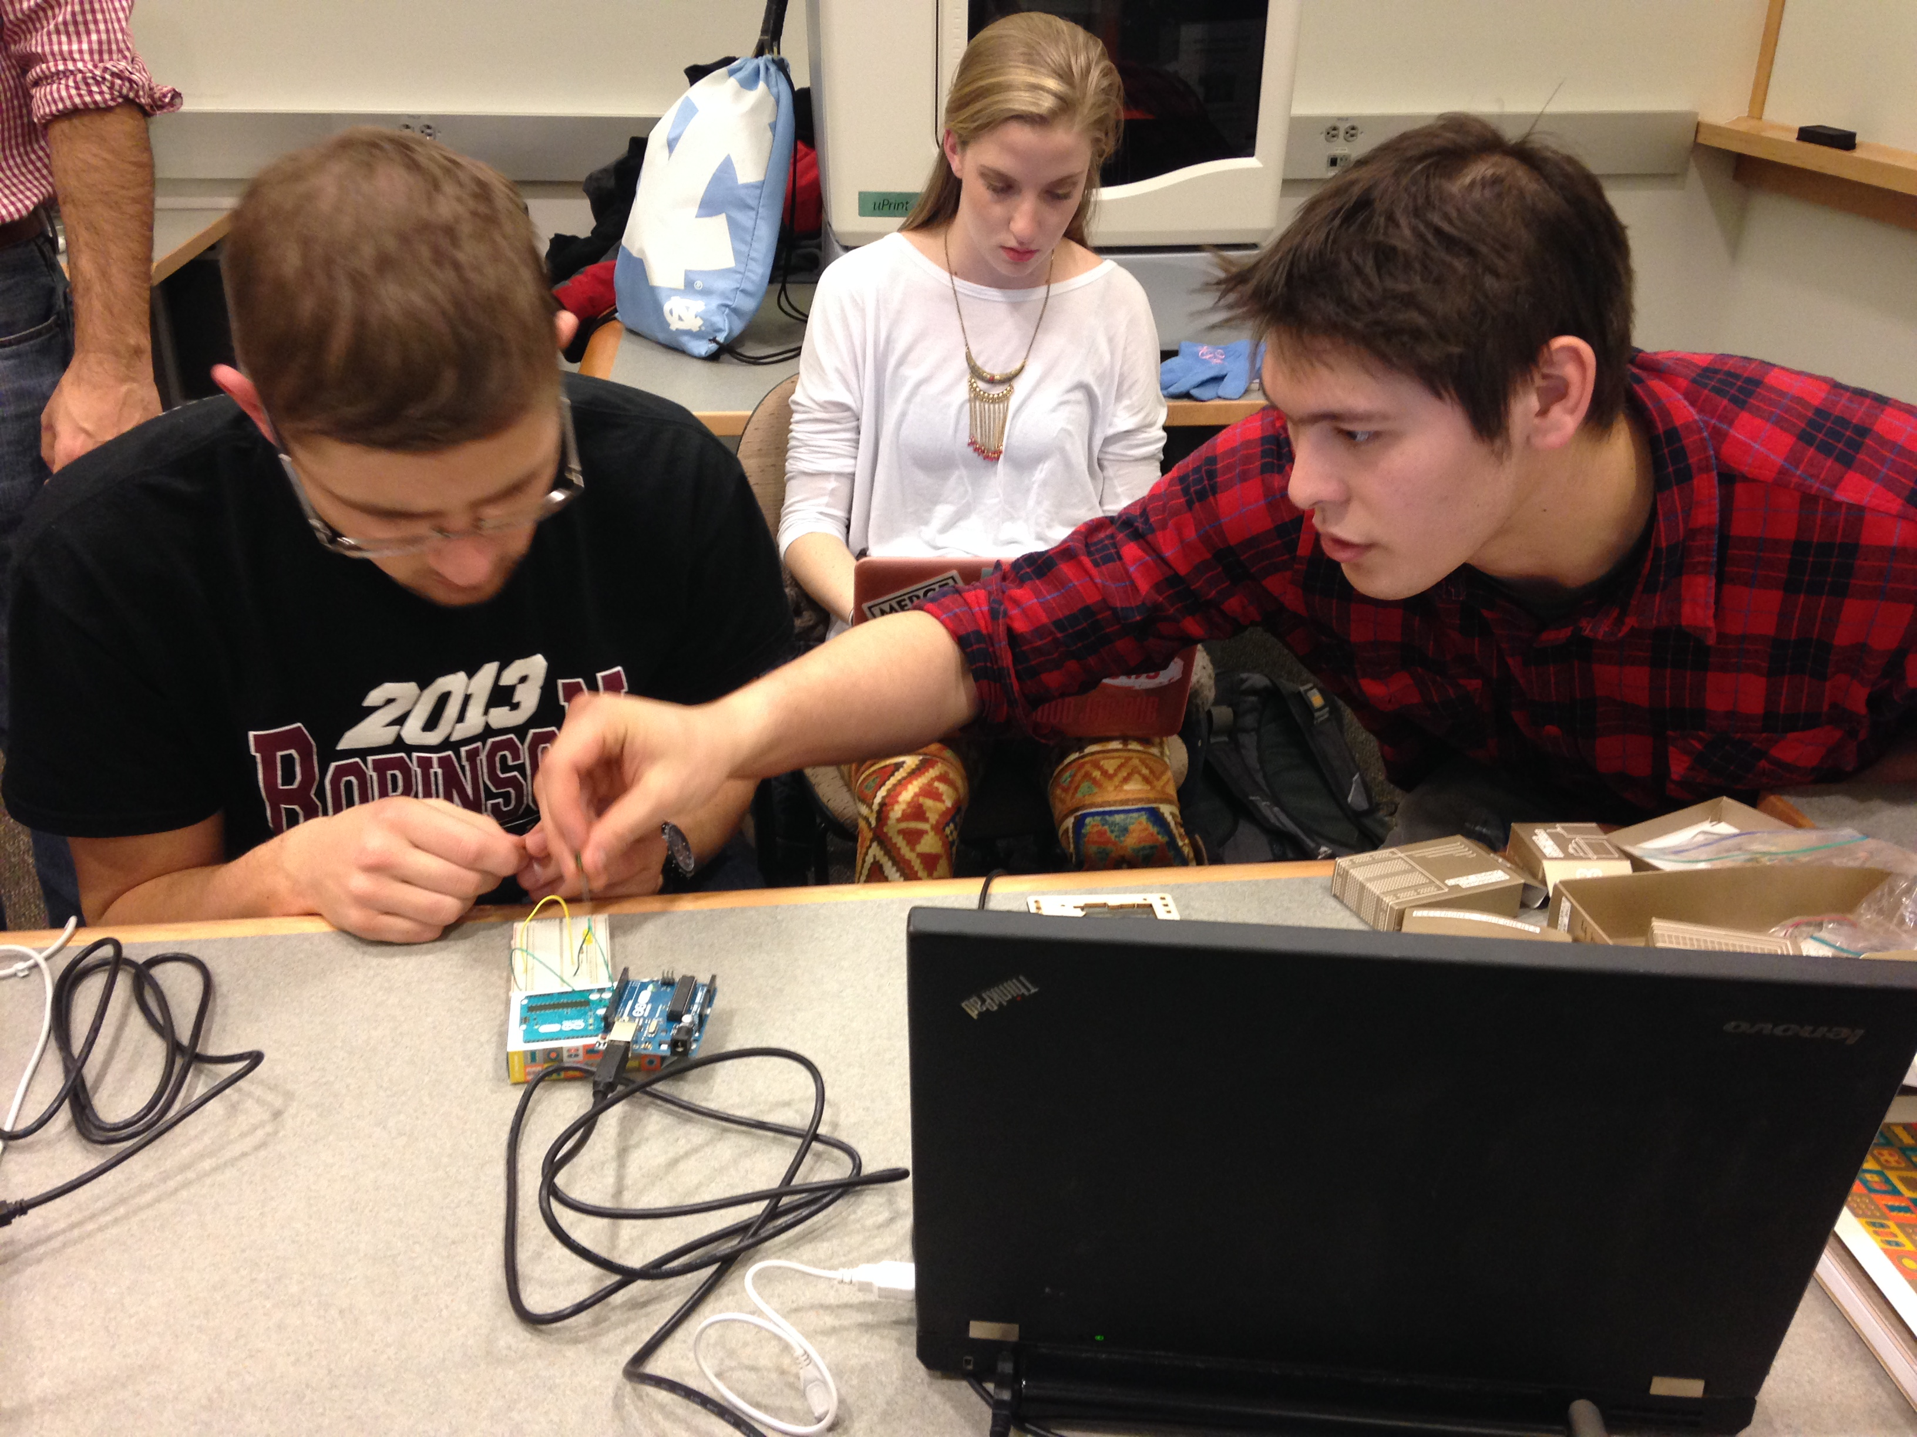
Kenan Science Library

Slide 11
Kenan Science Library Research Hub
Makerspace
3D Design, Printing and Scanning
Arduino, Raspberry Pi and electronics soldering station
Creativity center (drawing & modelling materials )
Co-working space
Collaborative group work area
Reservable group study rooms
“Hearth” – comfortable seating
Notes:
Makerspace
Part of a larger campus-level effort to support innovation and making.
Technology - four Makerbot 3D printers, one Stratasys uPrint Se Plus.
NextEngine 3D scanner and a h; Arduino and Raspberry Pi microcontrollers; electronics soldering station;
Creativity center (drawing and modelling materials, play-doh, legos, K’nex, games – get in the creative mind-set)
Co-working space - Provides a social work environment. Individuals can work independently as well as collaboratively in groups. A place for those with ideas to network and connect with a like-minded group of people for ideation, feedback, and to share expertise and resources. Open to all, not restricted to early stage entrepreneurs. 4 reservable meeting rooms.
Hearth – Area for informal gathering of the maker and innovation community
The overall goal - a space that nurtures and inspires creativity and making as well as providing a focused place to accomplish work.

Slide 12
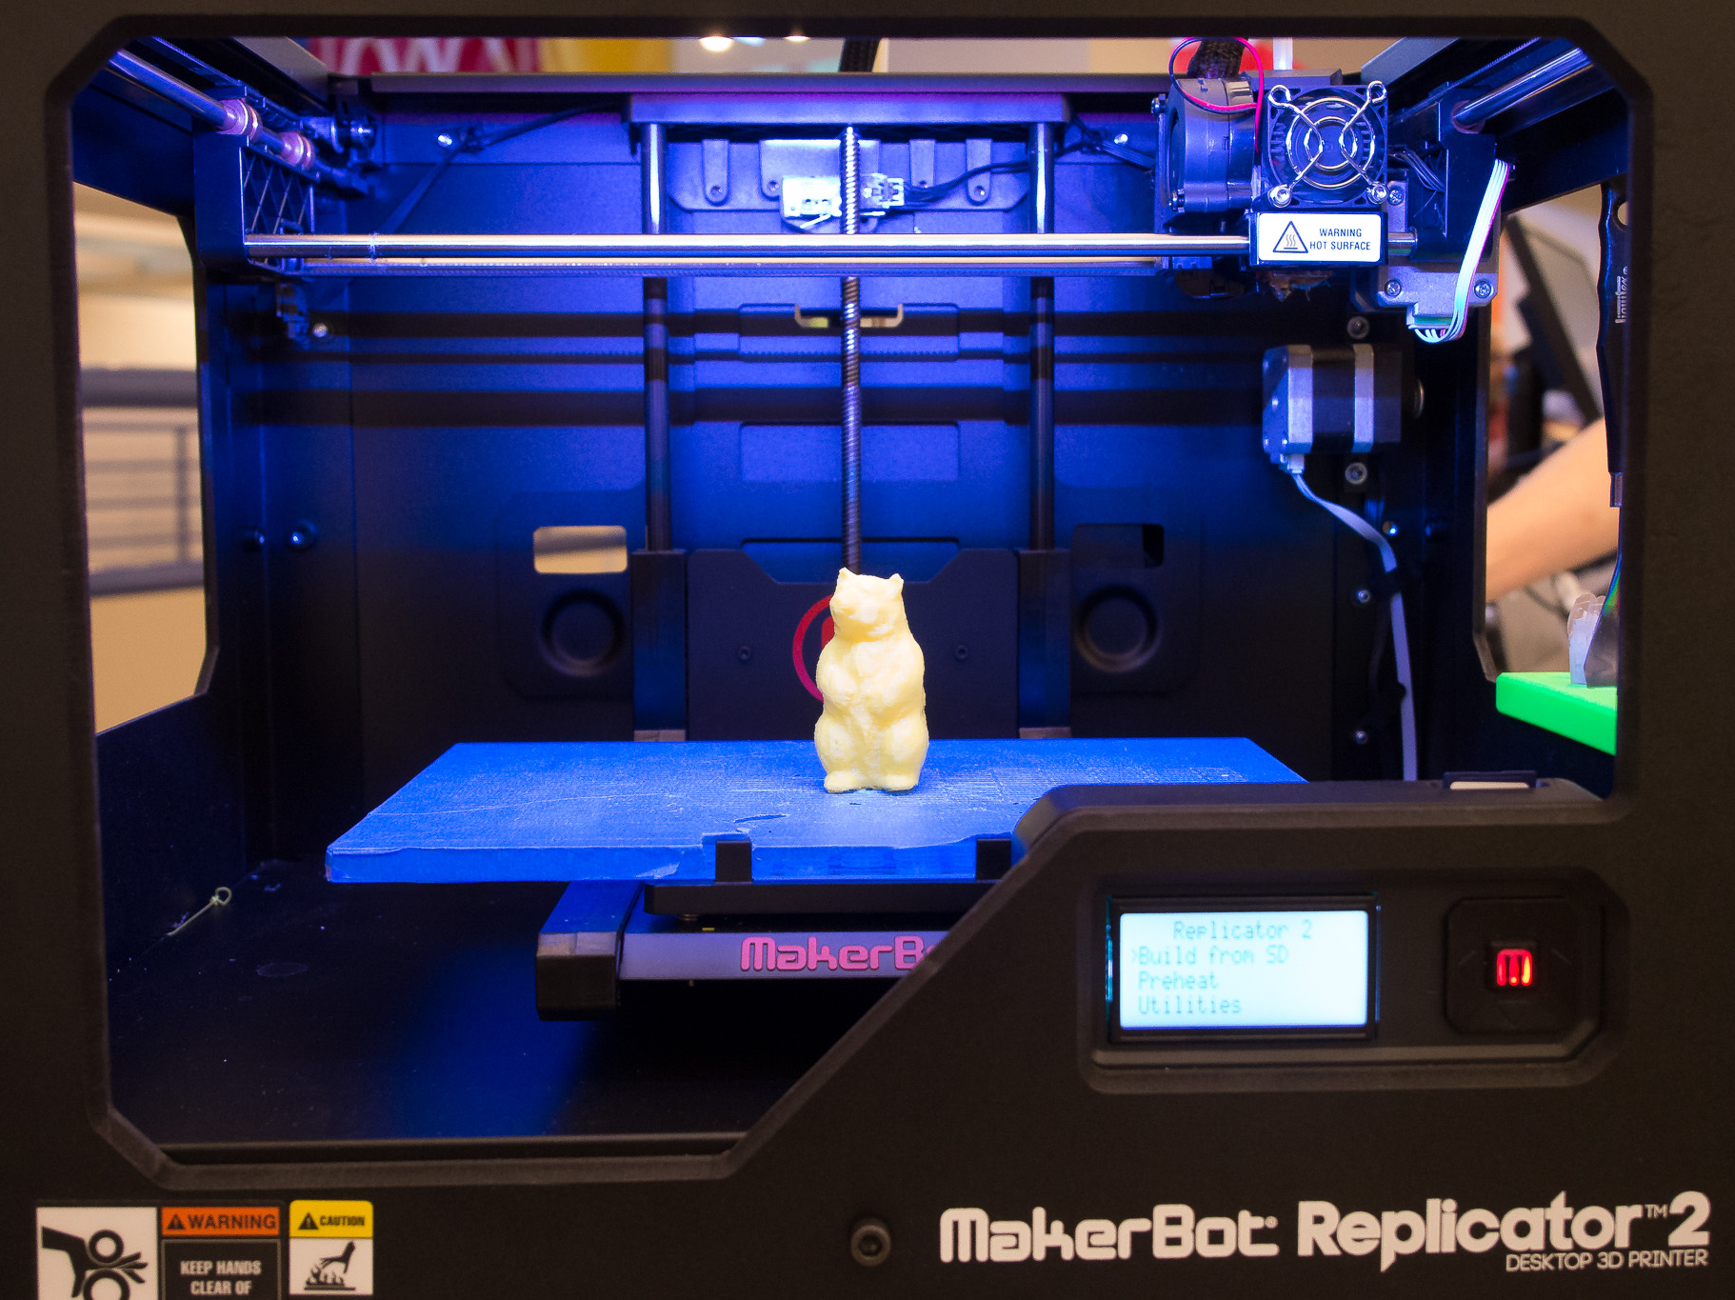
Kenan Hub Services
3D printing and scanning
3D design consultations & workshops
Support for classes and research projects using maker technology
Data, citation and reputation management
Company, industry, market & patent research consultations
Notes:
Supporting individual research (3D models, scans of cultural objects to be repatriated), teaching (molecular models), rapid prototyping (test tube caddies), creative projects
Makerspace
Questions should be sent to kenanmakerspace@listserv.unc.edu
No charge for 3D printing this year. Non-commercial work.
IP policy will be posted on web site
Largest printed object size is 6 x 6 x11 inches
Many colors available but can only combine 2 solid colors
3D printing time involved depends on many factors, from 5 min – 24 hours. Example test cube of 1x1 inches 10 minutes
3D printing file type – anything that can be converted to .stl file format
Largest scanned object size 16 inches X 22 inches
3D printing resolution= 0.1 mm
3D scanning accuracy between .015 and .05 inches depending on settings
3D scanning – 30-60 minutes depending on degree of detail
Scanner output is in .stl but can be converted
Entrepreneurship support
FYI staffing leads Josiah and Danianne. Rebecca consultant. Partner with Kenan Flagler Private Enterprise Institute. Josiah, company, industry, market research consultations. Information sources for developing a business plan.

Slide 13
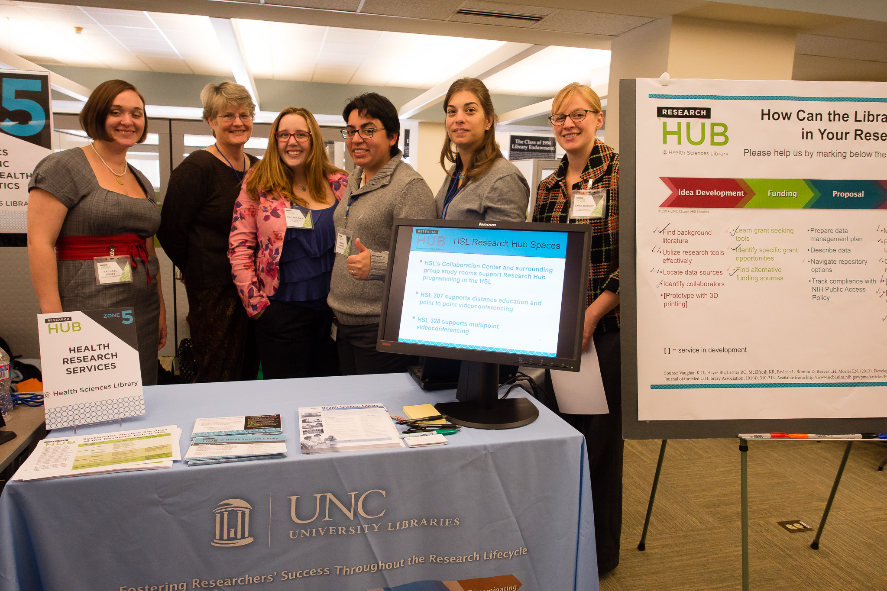
Partnerships
Notes:
We provide spaces, tools, resources, referrals, and expert staff to actively advance research in partnership with organizations on campus who offer complementary services. Partnerships are a more formal arrangement and we also have less formal collaborative relationships with many other organizations on campus.

Slide 14
Research Hub Partners
Howard W. Odum Institute for Research in Social Science
Center for Faculty Excellence
NC Translational and Clinical Sciences Institute (NC TraCS)
Carolina Health Informatics Program (CHIP)
REACH NC
Notes:
Interdisciplinary
State-of-the-art digital archive
Advanced research methods training
One-on-one consulting for faculty and grad students
Grant management and submission help
Emphasis on adding value to the process
“Customer focused” and “customer driven”
Leading and following: It’s not “either/or”
The key is to use technology to help our “customers” – not to drive the process
Pan university center for faculty across the arc of their career
Three program areas:
Research
Leadership
Teaching and Learning
[Molly’s slides]
Course redesign
We started a program on course redesign in 2006 with faculty members who teach more than100 students, and we now work with faculty and departments on classes of any size. Faculty have found that their students learn more when they provide: regular feedback for students; multiple opportunities for students to interact with their peers about what they are learning; and more class time for learning activities. Through this work, faculty have also developed discipline-specific instruction to better serve under-represented student populations who may not perform well in large, traditional lecture classes. Faculty have published on this data.
FFFP :
The Future Faculty Fellowship Program introduces graduate students evidence-based teaching practices relevant to their discipline, as well as pedagogies and teaching approaches from other disciplines. The program also helps graduate students understand the roles and responsibilities of faculty members at different types institutions of higher education.
For the last ten years, we held FFFP in a formal room, with a prominent podium, a grand piano and a stage. The program had not changed much during this time. We had the same handouts, the same instructors, and the same format. We have spent this past year redesigning the program and we are delighted to move FFFP to the research hub. We want graduate students to take advantage of all that Davis and ODUM have to offer. We want them to try out new ideas and consider the possibility that their teaching might inspire a new direction for their research.

Slide 15
Other Collaborators
UNC CreatorSpace
Kenan Flagler Institute of Private Enterprise: Research Services and KM
UNC Minor in Entrepreneurship
MakNet student group
Digital Innovation Lab

Slide 16
Research Hub Stories

Slide 17
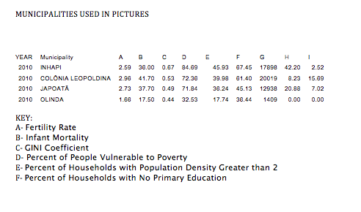
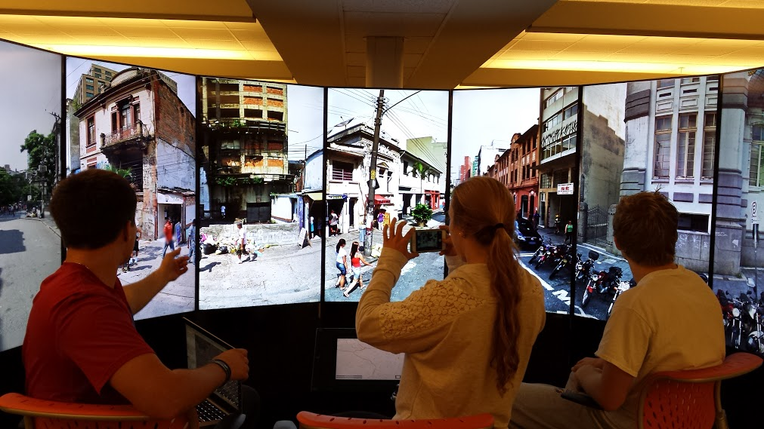
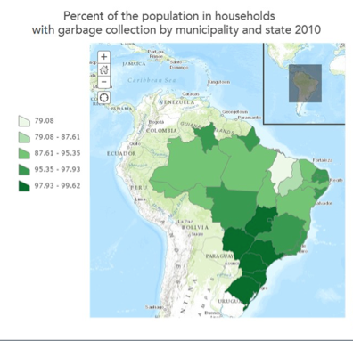
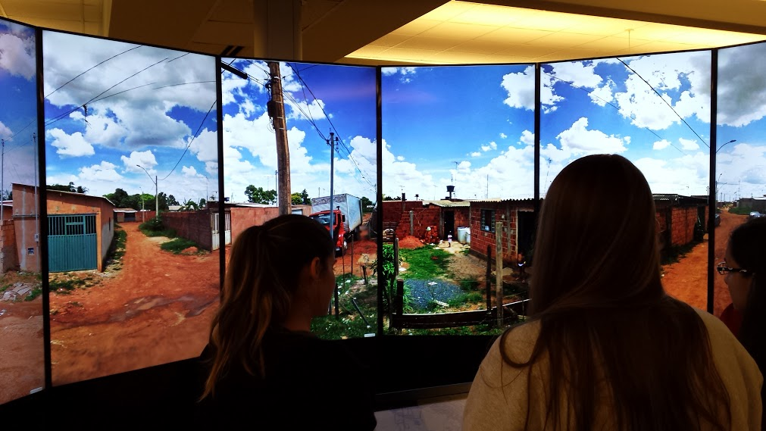
Geography 121: Human Geography
Notes:
Locate data
Analyze data
Create maps of income inequality
Use the LG to

Slide 18
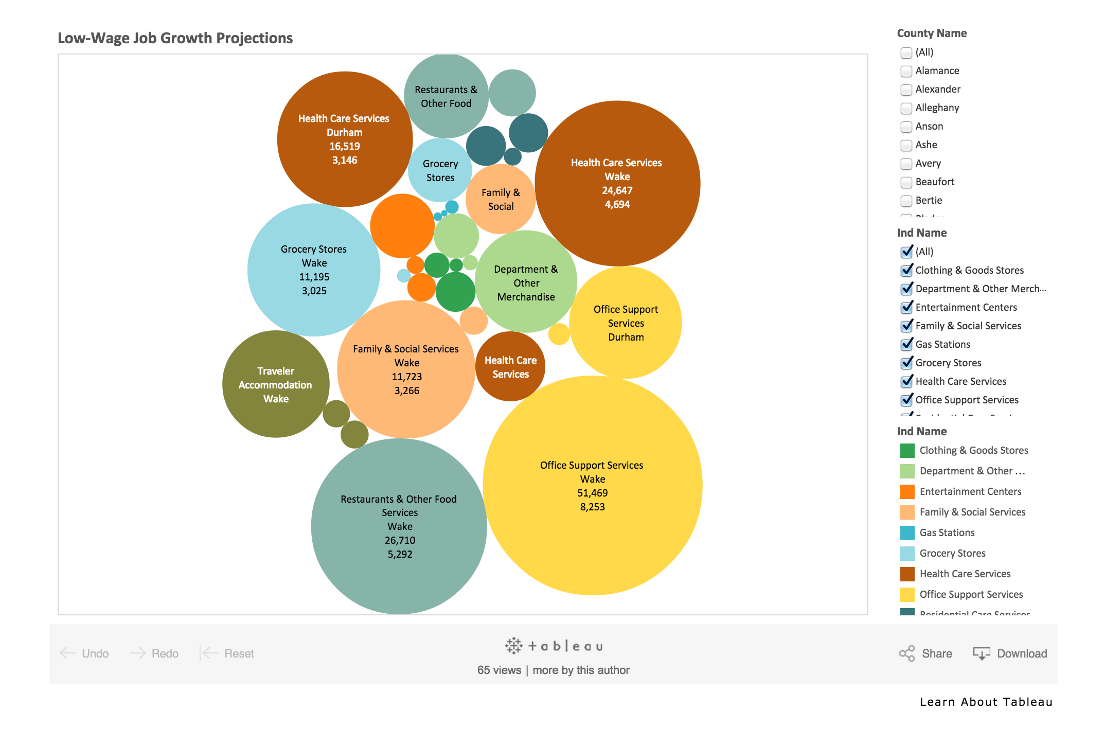
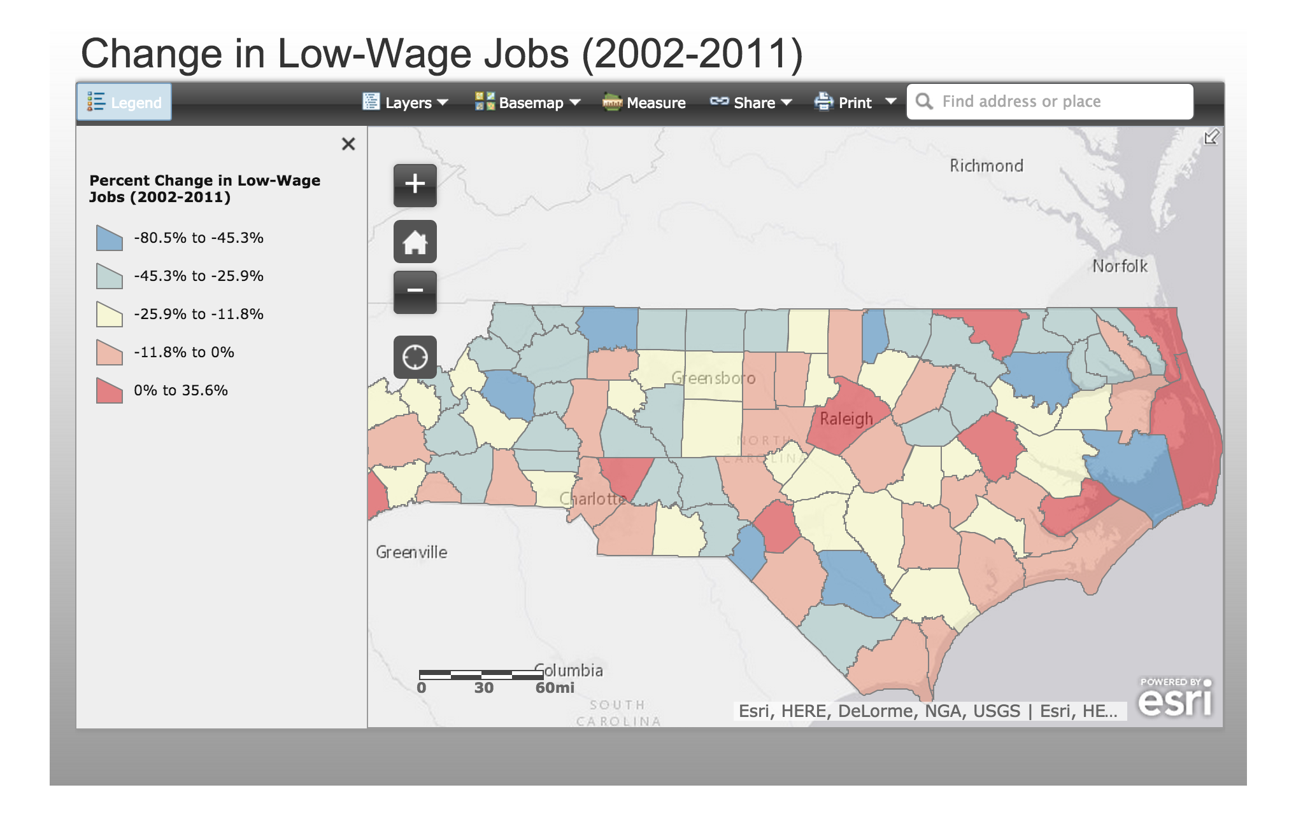
The State of Low Wage Work in North Carolina
http://lowwagenc.org
A collaborative project of the Center for Poverty, Work & Opportunity and the Department of City and Regional Planning Masters Workshop
http://www.lowwagenc.org/job-trends/
Notes:
http://www.lowwagenc.org/job-trends/
Center for Poverty Work and Opportunity and Department of City and Regional Planning Masters Workshop
Tableau
ArcGIS Online

Slide 19
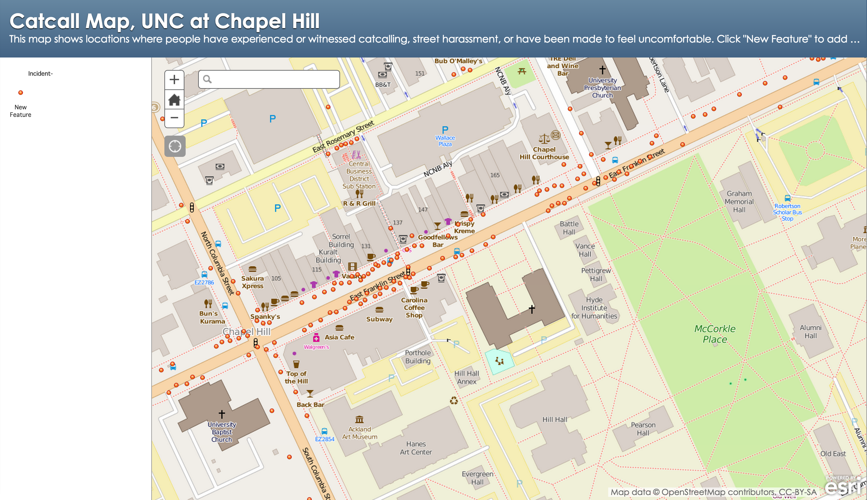
Catcall Map
Map created by Anondo Banerjee and Amanda Henley, GIS Librarian at the Davis Library Research Hub.
http://bit.ly/1y5zreF

Slide 20
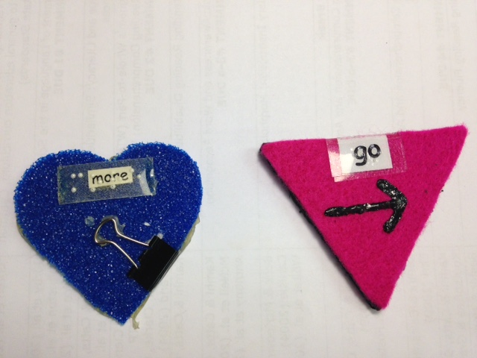
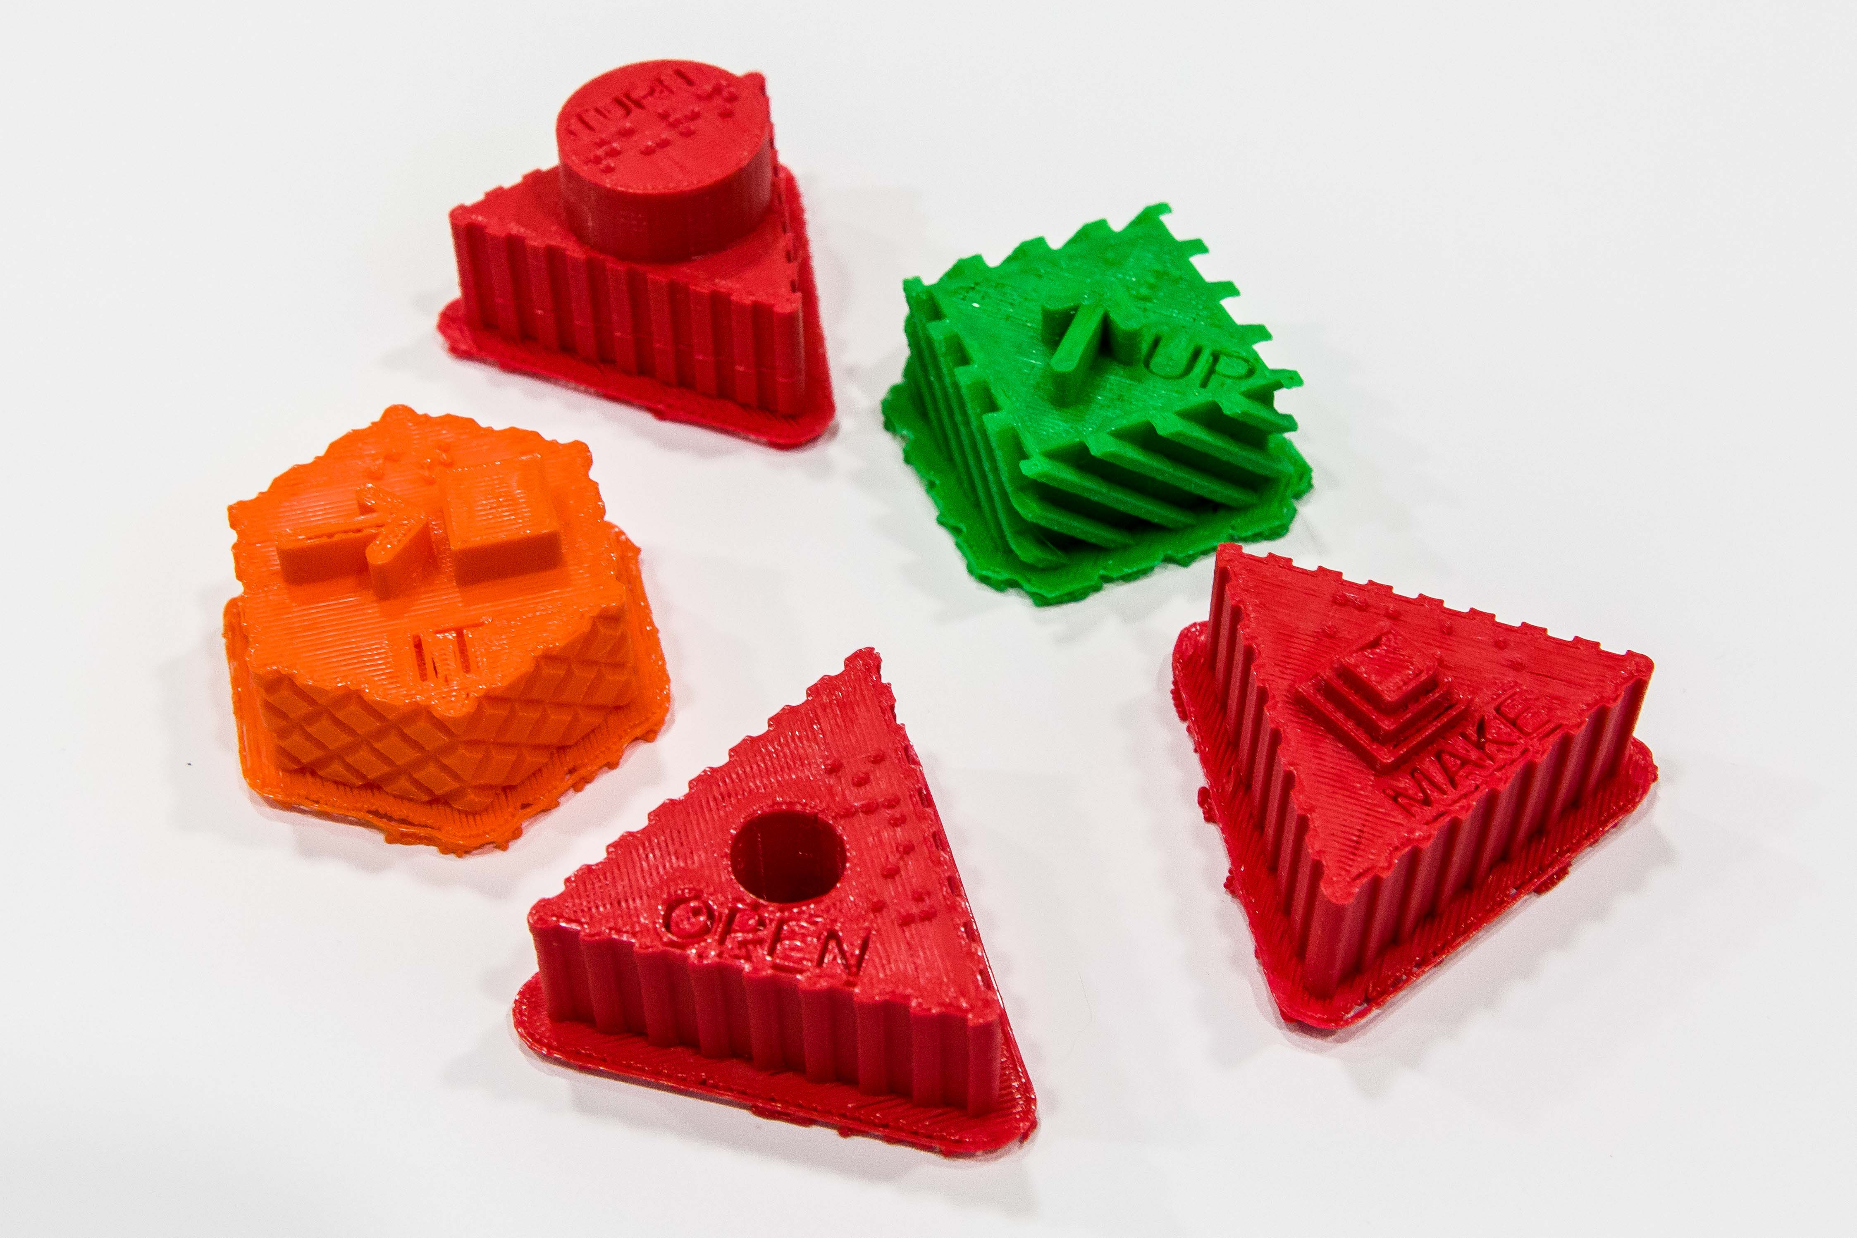
Tactual Symbol CAD File Creation and 3D Printing
Department of Allied Health Sciences. Center for Literacy & Disability Studies
Notes:
Karen Erickson, Department of Allied Health Sciences. Center for Literacy & Disability Studies
Our work focuses largely on students with significant, multiple disabilities. One of our recently funded projects involves building communication systems for students with significant, multiple disabilities who are also blind. We are building a system of tactile symbols and are looking for support to create the CAD (is that even the right term?) files that would then be sent to the printer. We have historically built these symbols using cardboard, fabric, and hot glue! Moving to 3D printing opens some great opportunities for two primary reasons (1) much more consistency in the product (2) dramatic reduction in the choking factor.
Each element helps conveys meaning color, texture, braille, written word
3) Open educational resource – make files available for printing by anyone working with this population

Slide 21
Thank you
Jill Sexton
Head of Digital Research Services
UNC Chapel Hill Libraries
jill@email.unc.edu
library.unc.edu/hub
library.unc.edu/makerspace
hsl.lib.unc.edu/hub

