Slide 1
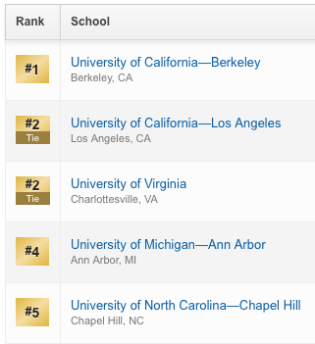
Recent Carolina Rankings
Pell (2012–2014)
Pell (2008)
Pell Change
Vassar
Grinnell
UNC–Chapel Hill
Smith Amherst
Harvard
23
24
21
23
20
17
12
14
13
16
16
13
+11
+10
+8
+7
+4
+4

Slide 2
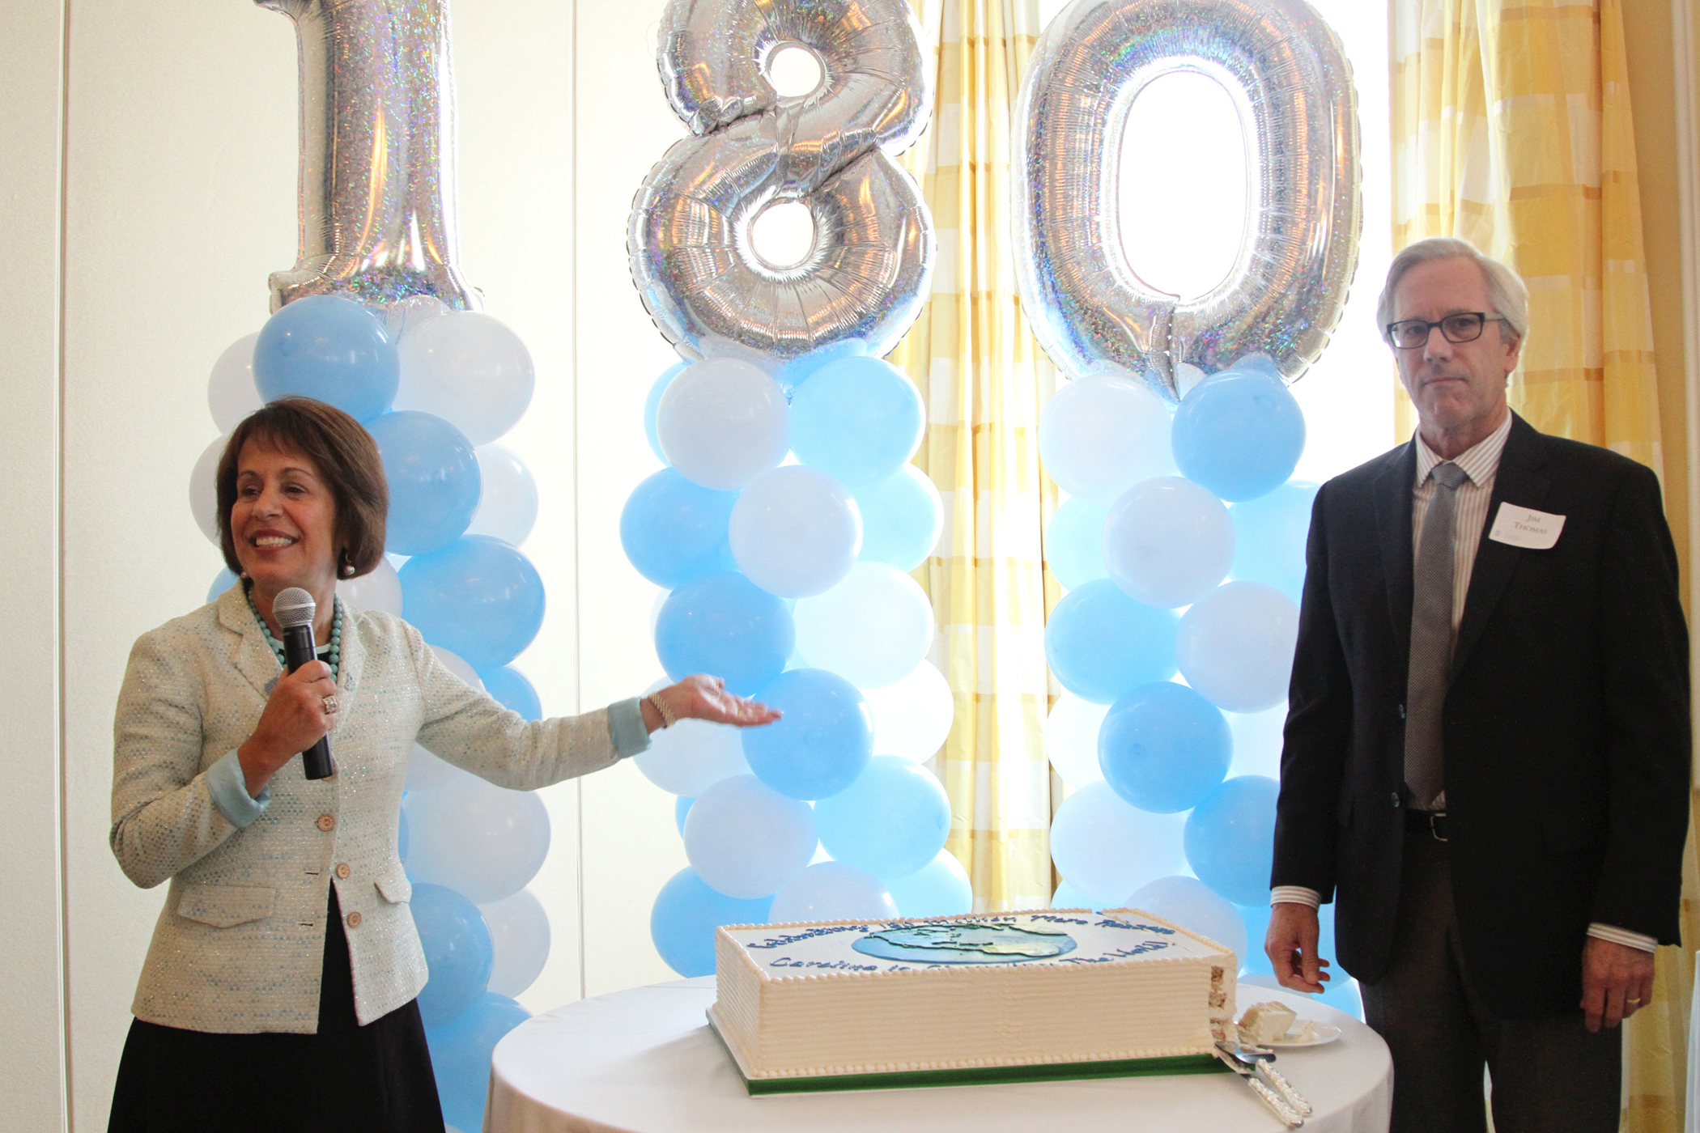
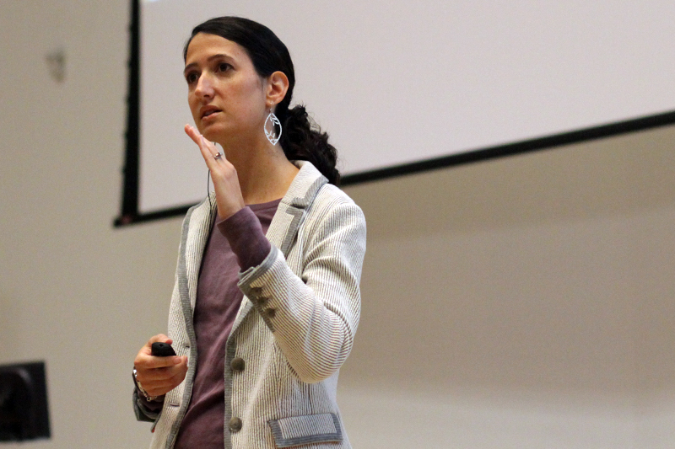
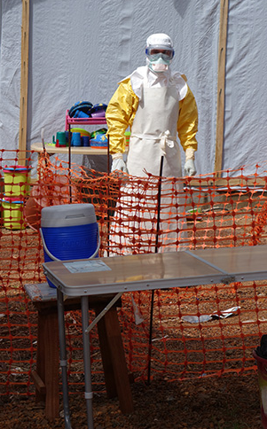
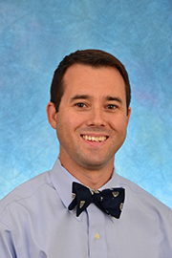
Faculty Highlights

Slide 3
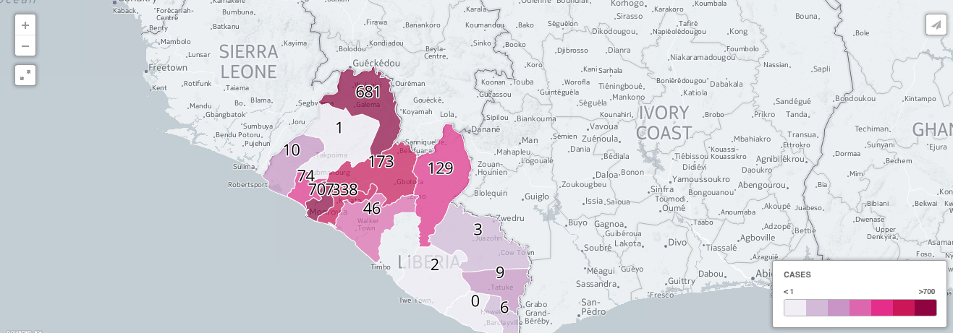
Ebola

