Slide 1

“Water In Our World” pan-campus theme first-year review
UNC Faculty Council Meeting
Friday, October 4, 2013
Terry Rhodes and Jamie Bartram, Co-chairs
Water Theme Steering Committee

Slide 2
Background
Inspired by UNC Academic Plan and approved by Faculty Council in Dec. 2011
March 22, 2012 (World Water Day) – Reading at Old Well from The Way of Water, UNC & US Water Partnership, and Holzworth professorship announcement
Officially launched in August 2012
Led by 17 member faculty steering committee along with parallel student organizing group
Over 60 events and activities held during 2012-2013 academic year related to theme
Initial budget of $110,00 used to provide partial or initial seed funding for selected activities and initiatives

Slide 3
Since the Water Theme derives its inspiration and purpose from the Academic Plan, our overview will mirror its 6 distinct themes
Work as an integrated university to attract, challenge, and inspire students through transformative academic experiences
Faculty: Prominence, Composition, Recruitment, Development, Retention, and Scholarship
Interdisciplinarity in research, teaching, and public engagement
Equity and Inclusion at Carolina
Engaged scholars and scholarship
Extend Carolina’s global presence, teaching, research, and public service

Slide 4



Work as an integrated university to attract, challenge, and inspire students through transformative academic experiences
Notes:
Student-led efforts included:
The design, printing, and placement of a series of stickers across campus in residence halls and other locations promoting sustainable water use
Directing of funds to Student Enrichment Fund of Student Government and the Campus Y Development Committee’s Fund to support student water projects
Student orgs such as A Drink For Tomorrow which hosted their annual One In Eight banquet supporting a sustainable water project in Las Cocas, Peru, as well as the sale of water art done by first-year student Caroline Orr

Slide 5
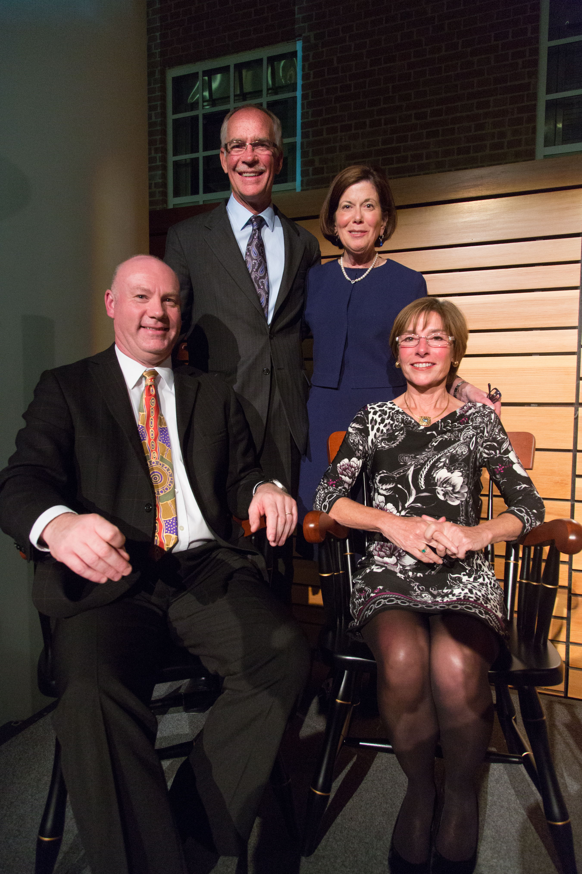
Faculty: Prominence, Composition, Recruitment, Development, Retention, and Scholarship
Notes:
Endowment of the Don and Jennifer Holzworth Distinguished Professorship Fund on March 22, 2012 (World Water Day)

Slide 6
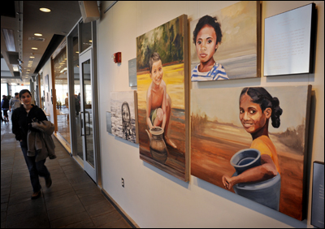
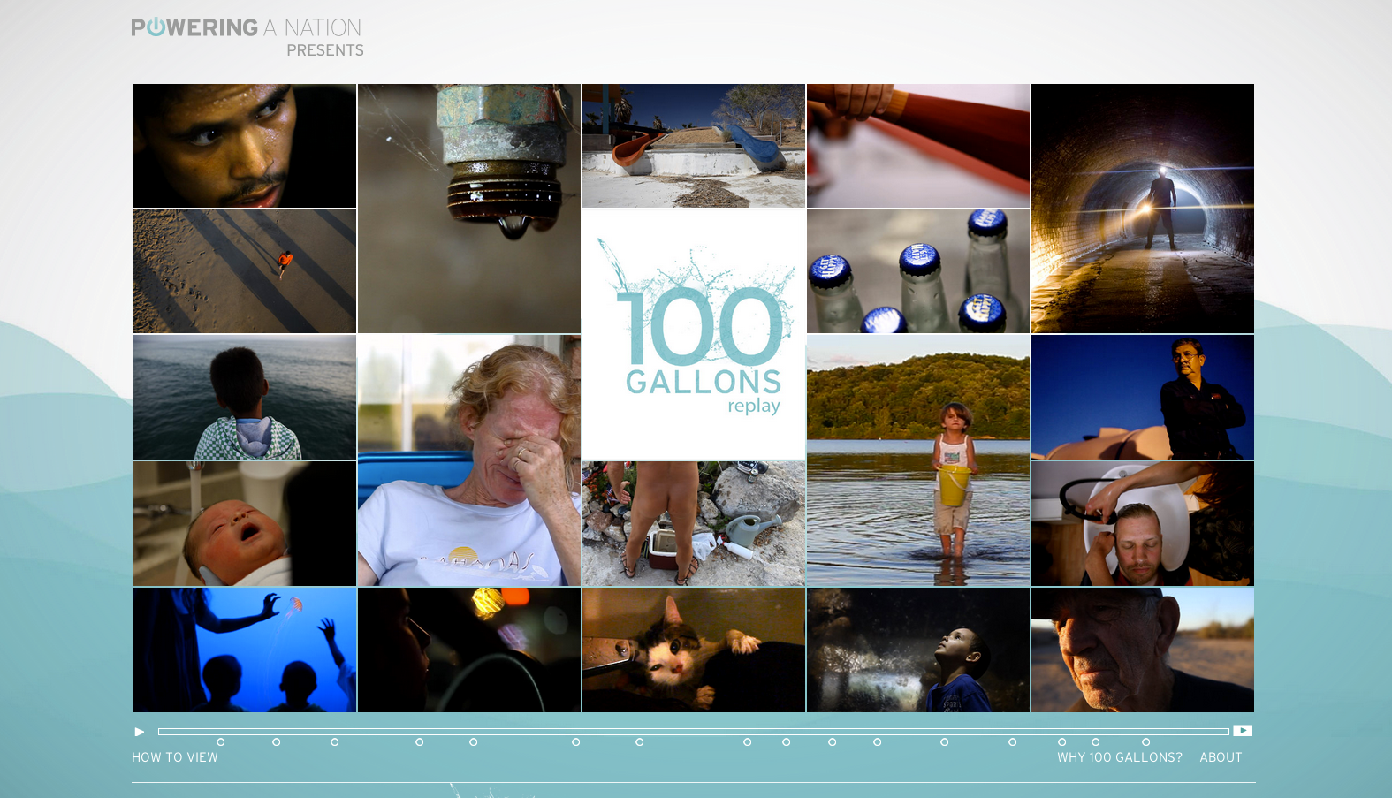

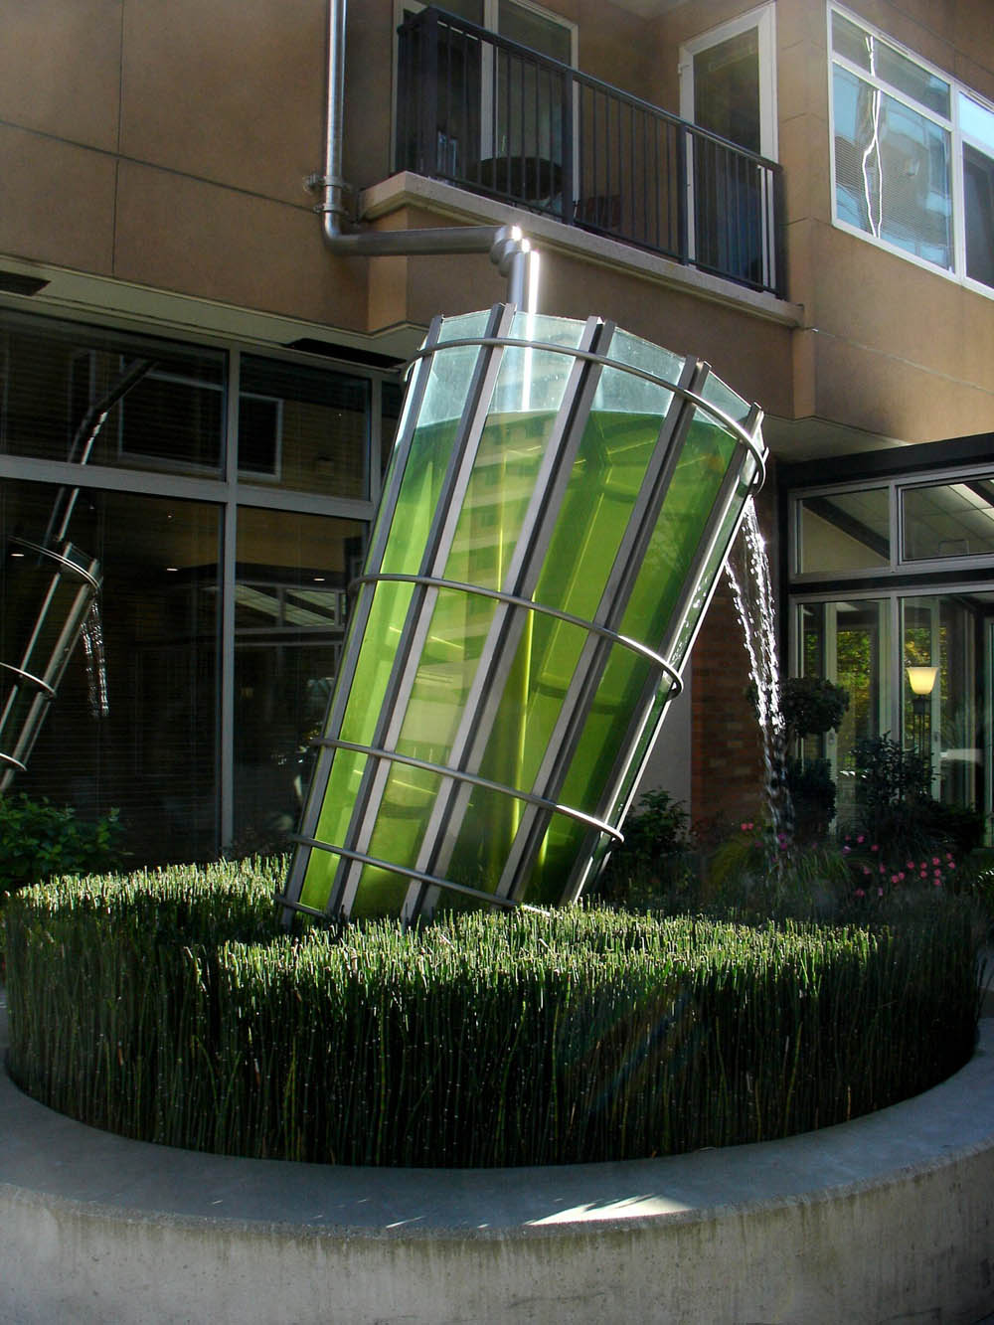


Interdisciplinarity in research, teaching, and public engagement
Notes:
- The Water of Life: Artistic Expressions exhibition in FedEx Global Education Center
- Journalism School’s Powering a Nation project “100 Gallons” and its more recent iteration “Water In Our World”
- Global Sustainability Symposium in February
Environmental artist Buster Simpson’s campus info-sculpture work
Upcoming performances by PlayMakers theater (The Tempest and Metamorphoses) and Carolina Performing Arts (Bland Simpson and the Carolina Coastal Cohorts, Compagnie Kafig)

Slide 7
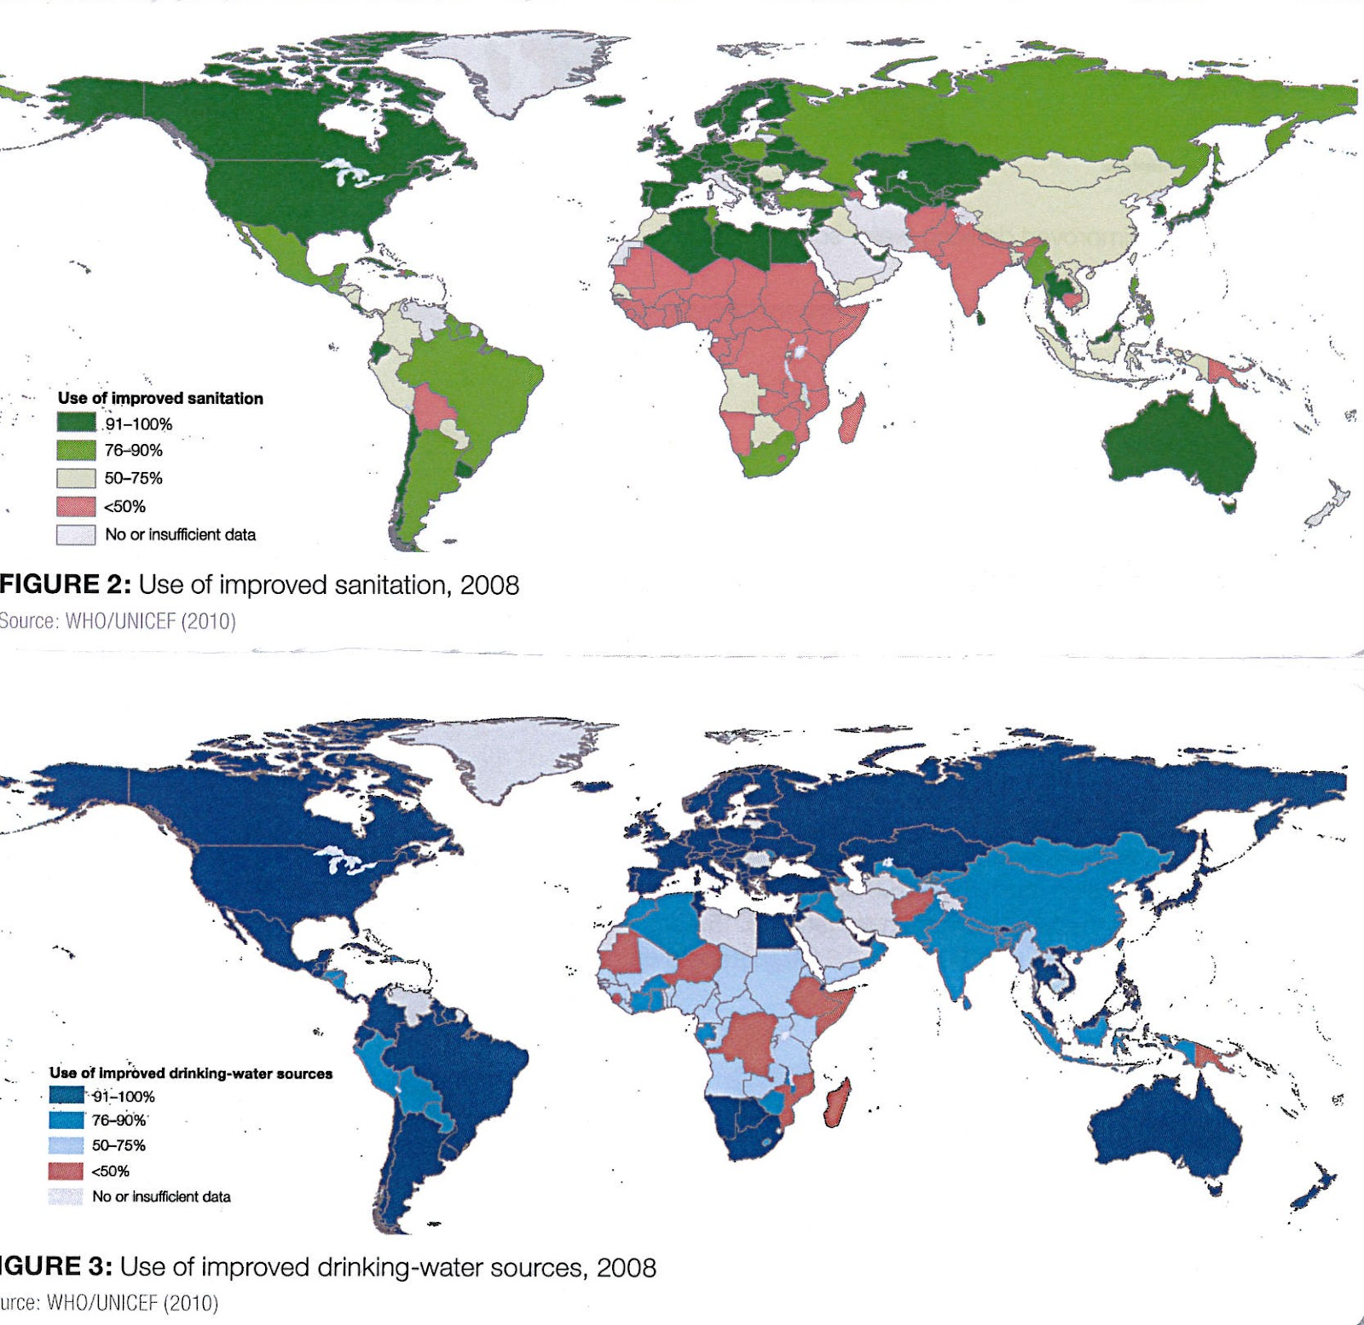
Equity and Inclusion at Carolina
Notes:
- Progressive realization of the human right to water and sanitation index

Slide 8


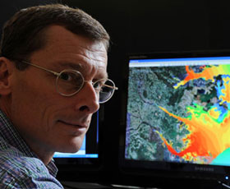
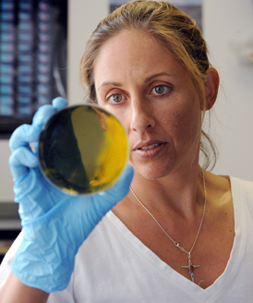
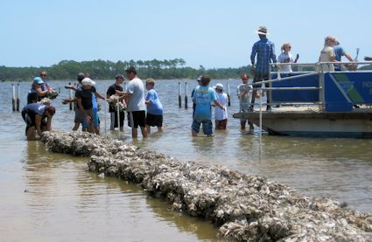
Engaged scholars and scholarship
Notes:
Environmental Finance Center’s EPA Small Water Systems project
NC Science Festival
Community activism in Rogers Road community over access to water and sewer utilities
Institute for Marine Sciences research on NC coast

Slide 9
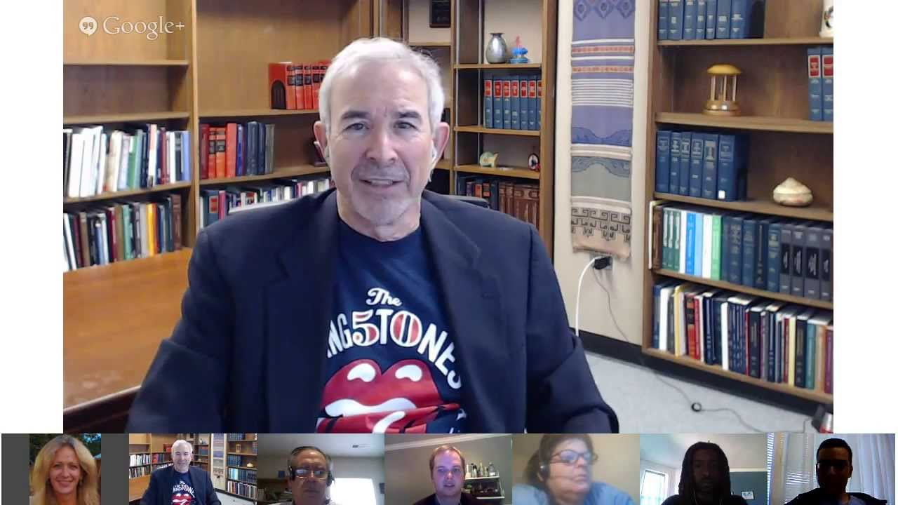



Extend Carolina’s global presence, teaching, research, and public service
Notes:
Environmental Law and Policy MOOC course taught by Don Hornstein
Global Research Institute selected water as their two year research theme along with a speaker series and water-focused fellows cohort
Proposal for a Water Theme/Carolina for Kibera legacy project in the works

Slide 10
Future Plans
The steering committee will continue to encourage and fund activity related to water for the 2013-2014 academic year.
A renewal of funding at the same level as 2012-13 has been requested and a meeting with Chancellor Folt and Provost Dean is scheduled for late October

Slide 11
Resolution for extending Water Theme for a third year
This would provide essentially needed time for longer-range initiatives to play out more fully, especially those just beginning to be launched (e.g. global water quality initiative)
Campus performance organizations (e.g. Carolina Performing Arts and PlayMakers Theater Company) require at least a year or two of lead time in scheduling events
New, interdisciplinary academic courses require time to plan and develop
The extra year also allows for a smooth transition between the current and future themes without one stunting the momentum of another

