Slide 1
UNC Budget Process Update
Faculty Council
December 6, 2019

Slide 2
UNC BUDGET DEVELOPMENT PLAN
Why?
University has never operated with an all-funds, prospective budget
Current decentralized and fragmented operating environment makes decision-making based on “University” perspective difficult
Lack central strategic investment funds
Ambitious goals of Blueprint for Next require investment

Slide 3
UNC BUDGET DEVELOPMENT PLAN
Goals
Improve understanding, transparency and visibility
Establish common baseline of revenues and expenditures
Optimize allocations/future spending decisions
Status
Completed 35 individual unit budget discussions over two months
Operating at recurring funding levels from last year (“continuing resolution”)
Adjustments may be necessary once a legislative budget is final

Slide 4
Strategic Focus and UNC Strategic Priorities
Blueprint for Next lays out bold aspirations, which will require investment.
Key Budget Priorities:
Increase faculty salaries to approach salaries at peer institutions;
Provide consistent and ongoing resources for faculty start-up funding;
Raise cash flow and liquidity margins closer to Aaa rated peer institutions;
Begin resolving long-term structural instability of central strategic funds;
Address long-standing, significant deferred maintenance needs

Slide 5
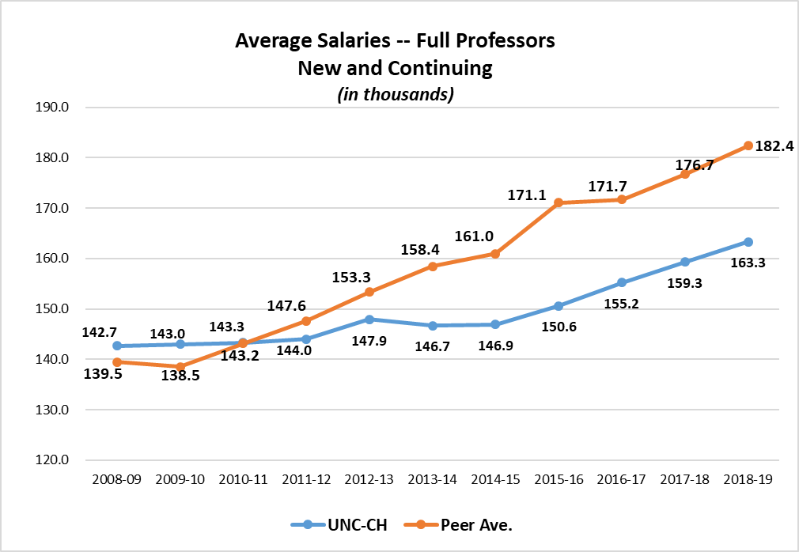
Full Professors -- UNC-Chapel Hill vs. Peer Average Salary Trends
In 2008-09 and 2009-10, UNC-Chapel Hill full professor salaries were above the average for our peers.
In 2011-12, full professor salaries fell below the peer average and have never recovered.

Slide 6
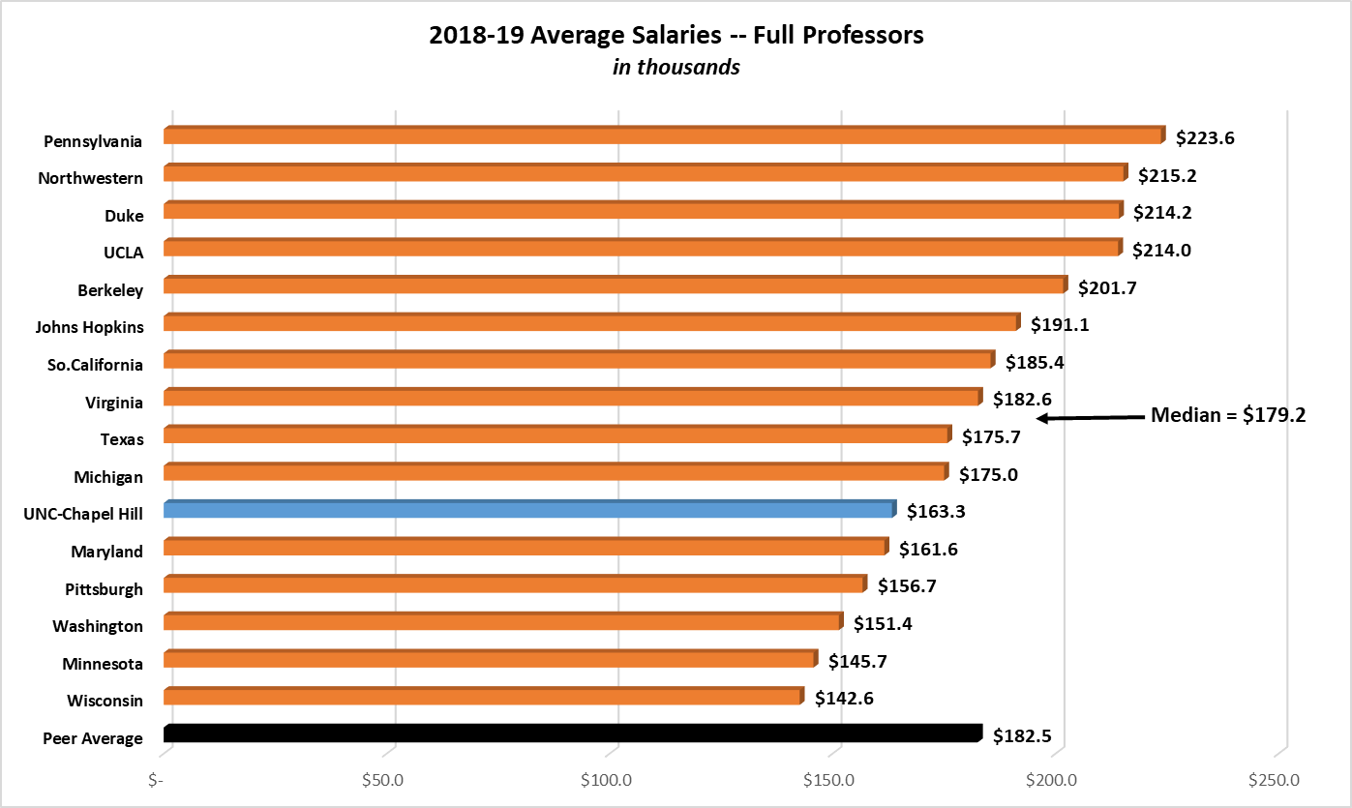
Current Competitiveness of UNC-Chapel Hill Full Professor Salaries

Slide 7
Associate Professors -- UNC-Chapel Hill vs. Peer Average Salary Trends
Trends in associate professor salaries are similar to those of full professor salaries.
In 2008-09, UNC-Chapel Hill salaries were even with the average for our peers but fell behind in subsequent years.
In 2018-19, the gap between UNC-Chapel Hill associate professor salaries and the peer average was over $16,000.
Between 2009-10 and 2014-15, UNC-Chapel Hill salaries for continuing associate professors (not shown here) increased at only about half the rate of our peer group.

Slide 8
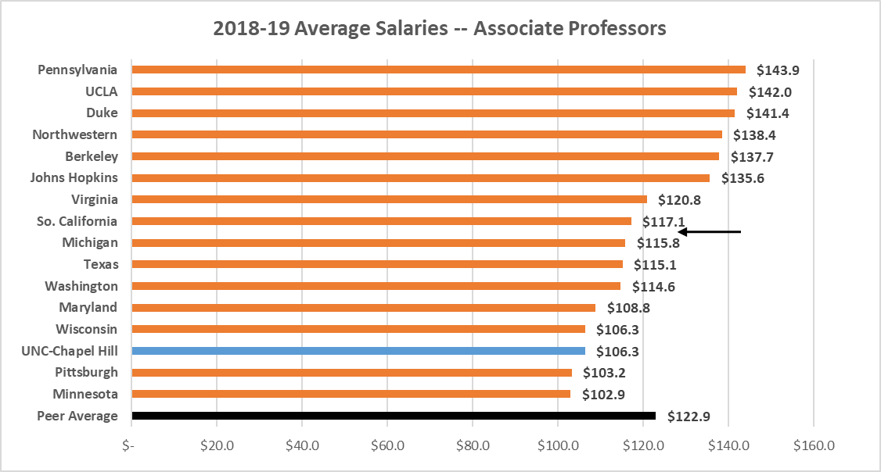
Current Competitiveness of UNC-Chapel Hill Associate Professor Salaries
Median=$116.5
Median = $116.5
19th percentile

Slide 9
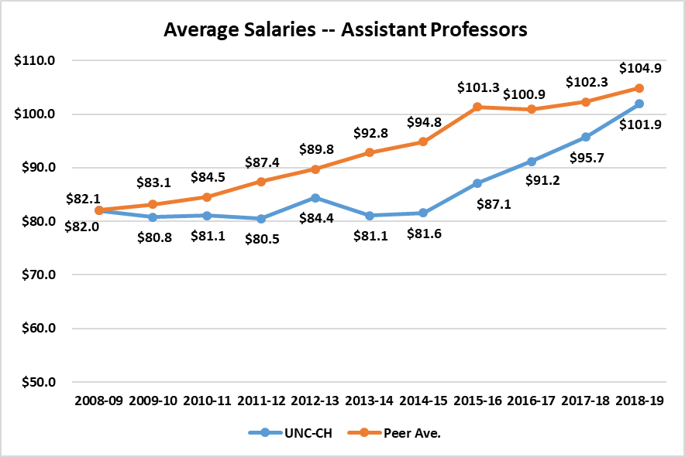
Assistant Professors -- UNC-Chapel Hill vs. Peer Average Salary Trends
In 2008-09, UNC-Chapel Hill assistant professor salaries were equivalent to the average for our peers, but fell behind in subsequent years.
In recent years, this gap began to close, and in 2018-19, UNC-Chapel Hill’s average assistant professor salaries were only $3,000 less per year than the peer group average.

Slide 10
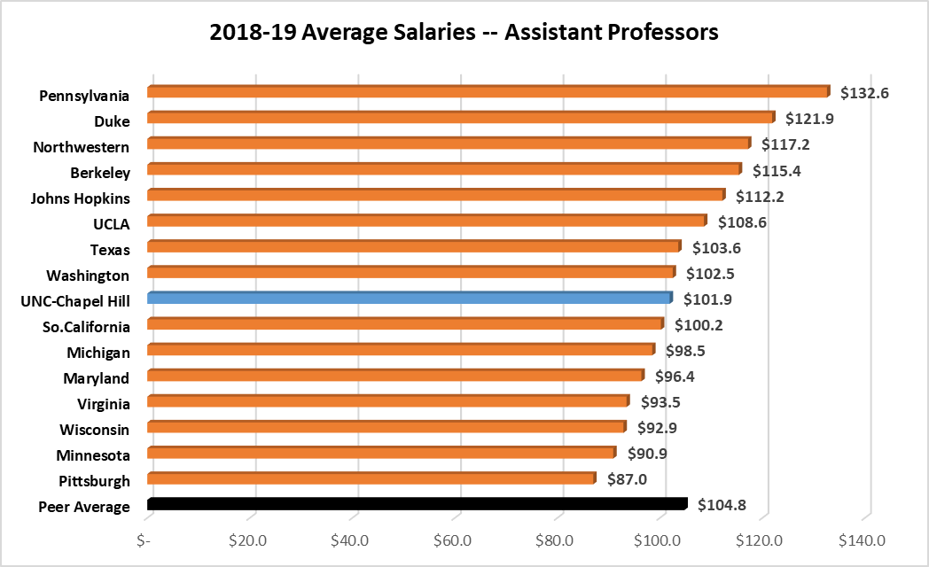
Current Competitiveness of UNC-Chapel Hill Assistant Professor Salaries
Median=$102.2

Slide 11
Deferred Maintenance: Range of Potential Actions
Policy Change
Increase carryforward authority
Use operating funds for R&R
Appropriations
State budget risk
BOG allocation methodology
Student Fees
- Considered $65 per student fee last year
Other
Potential P3 opportunity
Development effort
$850 M
Deferred Maintenance Needs

Slide 12
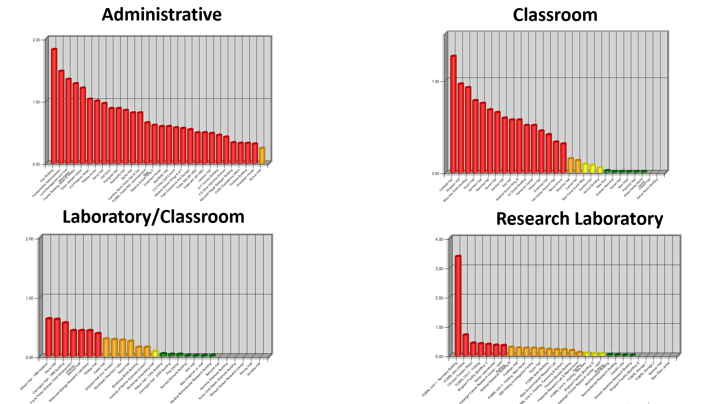

Slide 13
Questions?
Faculty Council
December 6, 2019

