Slide 1
The IDEAs in Action Curriculum
Faculty Council
February 8, 2019
4.25

Slide 2
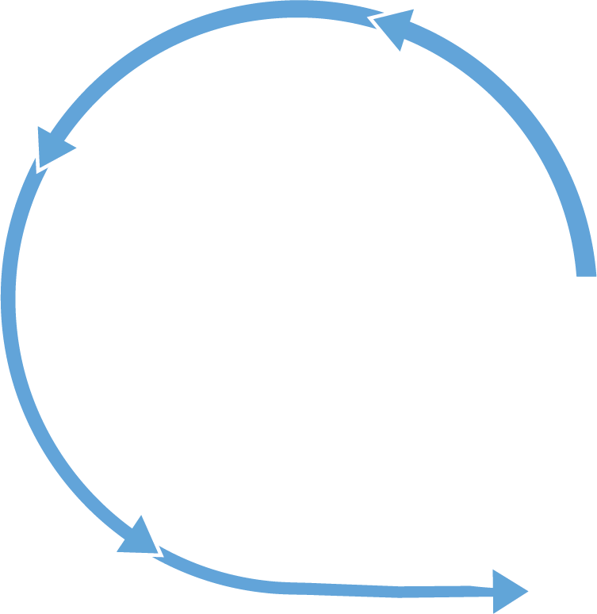
DISCOVER
Collect
Listen
Investigate
Observe
Experience
Understand
Notice
Consider
Synthesize
Communicate
IDENTIFY
EVALUATE
Create
Innovate
ACT

Slide 3
Liberal Arts Foundations
Liberal arts general education is key
How do we combine liberal arts foundation with the goals of general education?
Tradition?
Devolution?

Slide 4
Liberal Arts Foundation: Why?
What is it about the liberal arts that makes them a strong foundation for students?

Slide 5
Capacities
Ways of thinking and doing that can be used in multiple domains
Not (just) skills
Not course topics
Reasons why students should take this course
Help students understand curriculum coherently

Slide 6
Research on Student Learning
Changing student body
Thrive@Carolina
Far transfer
Recurrence
High-Impact Practices

Slide 7
Feedback & Response Since November (1/3)
Global Understanding & Engagement doesn’t focus enough on societies beyond the US, Canada, and Western Europe
Change language in capacity to emphasize societies beyond the North Atlantic region specifically
Recurring capacities are too onerous, will hamper faculty teaching quality and flexibility
Reduce the recurring capacities list substantially and offer additional flexibility

Slide 8
Feedback & Response Since November (2/3)
Too little attention to natural science and to hands-on lab learning
New capacity is Natural Scientific Investigation; new Empirical Investigation Lab is a fourth credit attached to a particular course.
New language in Ways of Knowing; Creative Expression, Practice, and Production emphasizes science pathways
Too little emphasis on data science
New fourth credit on III for Foundations of Data Science; new language in Ways of Knowing emphasizes data science; new language in Quantitative Reasoning emphasizes reasoning with data

Slide 9
Feedback & Response Since November (3/3)
Engaging with the Human Past is too broad, doesn’t ensure sufficient historical distance
Amended the Engaging with the Human Past capacity to require that courses must address a time period that is “remote.” Amended the Ways of Knowing capacity to emphasize that study of remote times or places is one way of developing that capacity.
What are the mechanisms for supporting the curriculum and departments’ resources?
College will support departments and protect against unforeseen negative consequences
Dean Guskiewicz will address this in a letter to Faculty Council

Slide 10
First Year Foundations (12 credits)
First-Year Seminar or First-Year Launch (FYS/FYL)
Small, faculty-taught courses
Writing at the Research University (ENGL 105)
Ideas, Information, and Inquiry (III)
Value of disciplinary and interdisciplinary discovery; new fields and approaches
Foundational skills: Data Science, Global Awareness, Collaboration, Communication
College Thriving (EDUC 101/U101)
Collaboration among SOE, CAS, Student Affairs, Advising
Self-regulated learning, campus resources, wellness

Slide 11
Focus Capacity courses (9 courses, 28 credits)
Aesthetic & Interpretive Analysis
Creative Expression, Practice, & Production
Engagement with the Human Past
Ethical & Civic Values
Global Understanding & Engagement
Natural Scientific Investigation
Quantitative Reasoning
Power, Difference, & Inequality
Ways of Knowing
One Focus Capacity course must carry an Empirical Investigation Lab (1 credit).

Slide 12
Focus Capacity courses: Recurring Capacities
Comprehensive approach to a substantive topic
Evidence, argument, uncertainty
Writing regularly (total at least ten pages or the intellectual equivalent)
Presenting material through oral presentations, webpages, or similar
Human difference and/or change over time as factors
Courses that do not meet one or more of these recurring capacities must include an explanation as to why such inclusion would be inappropriate for the topic area. The General Education Oversight Committee reviews these requests.

Slide 13
Additional Capacities & Characteristics (0+ credits)
Global Language (0-12 credits)
May be fulfilled through courses or other experiences:
Research and Discovery (0-3 credits)
High-Impact Experience (0-3 credits)
Communication Beyond Carolina (0-3 credits)
Campus Life Experience (0 credits)

Slide 15
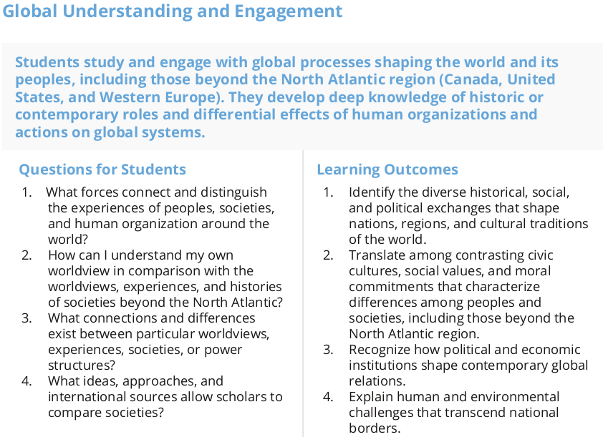

Slide 16
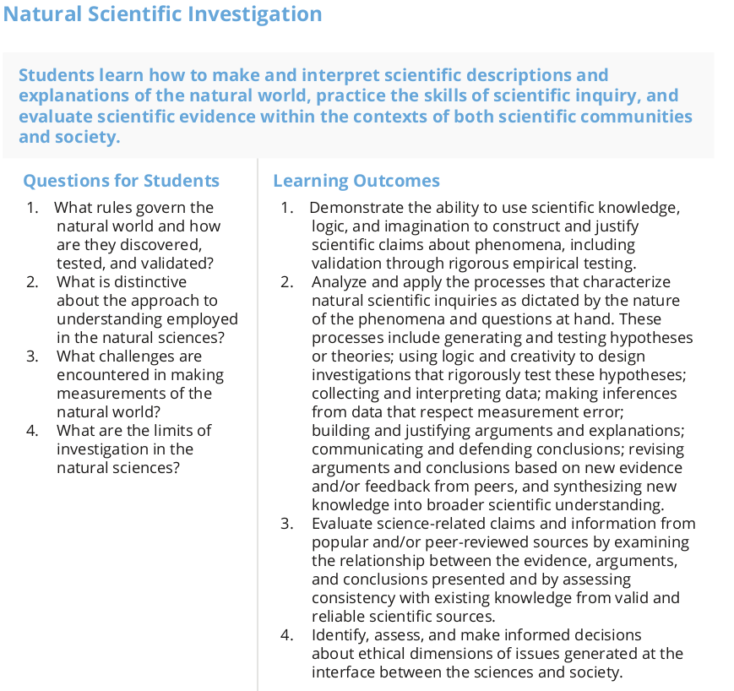

Slide 18
Implementation
Committee with faculty representation led by OUC
Goal: Fall 2020 (if feasible)
Implementation committee will return to FC with any unforeseen problems or necessary amendments
College has committed to support departments and the curriculum

Slide 19
Questions, Comments, Feedback
https://ideasinaction.unc.edu
IdeasInAction@unc.edu

