Slide 1
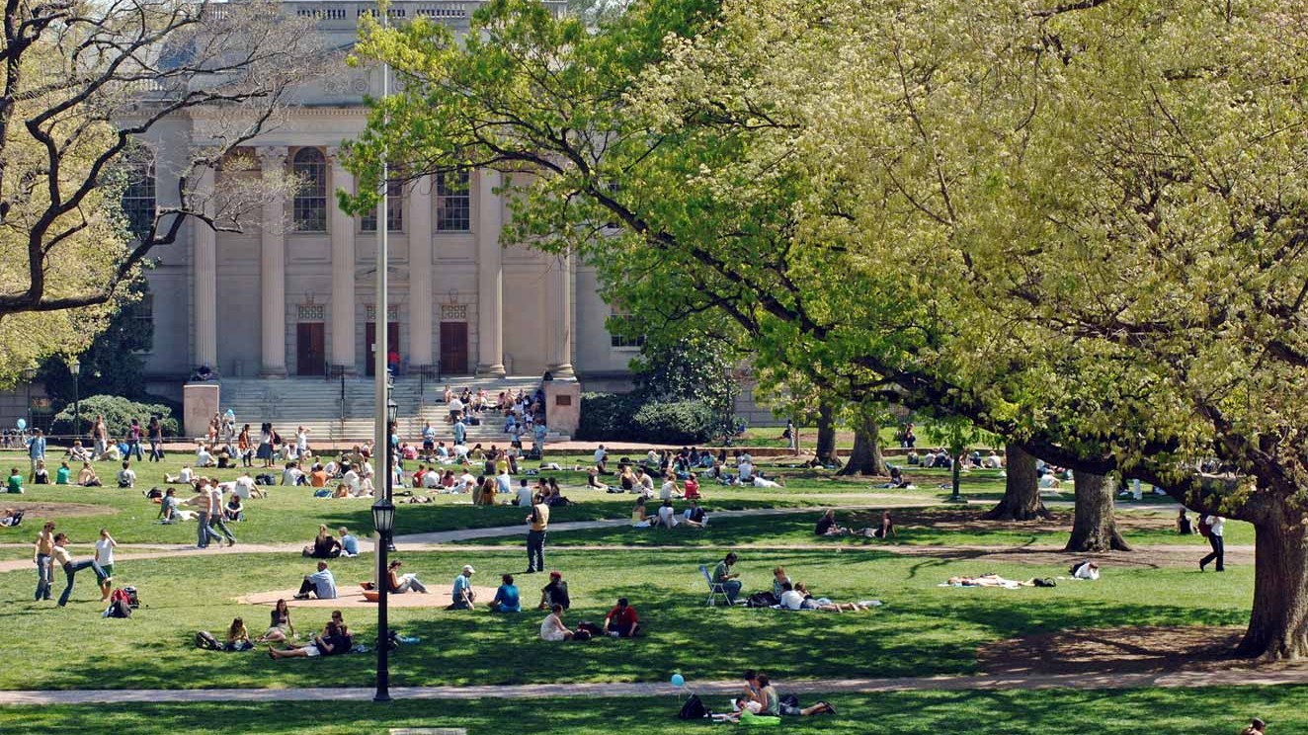
Faculty Athletics Representative Annual Report November 9, 2018
Lissa L. Broome
Burton Craige Distinguished Professor
Director, Center for Banking and Finance
UNC School of Law

Slide 2
Role of the FAR
All NCAA schools have a FAR
Role is defined by the Conference and the school
Appointed by the Chancellor and serve at her pleasure
Subject to a review every 5 years by an appointed review committee (last in 2015)
Advisor to the Chancellor and the Athletics Director and liaison to the faculty

Slide 3
Activities & Areas of Focus
Separate individual monthly meetings with the Chancellor and the AD
Ex officio, voting member of the Faculty Athletics Committee (FAC), which meets monthly during the academic year
Areas of focus: Academic integrity and academic success of student-athletes; Rules compliance; Positive student-athlete experience; Help represent the University before the NCAA and the ACC
Attend a lot of meetings, including…

Slide 4
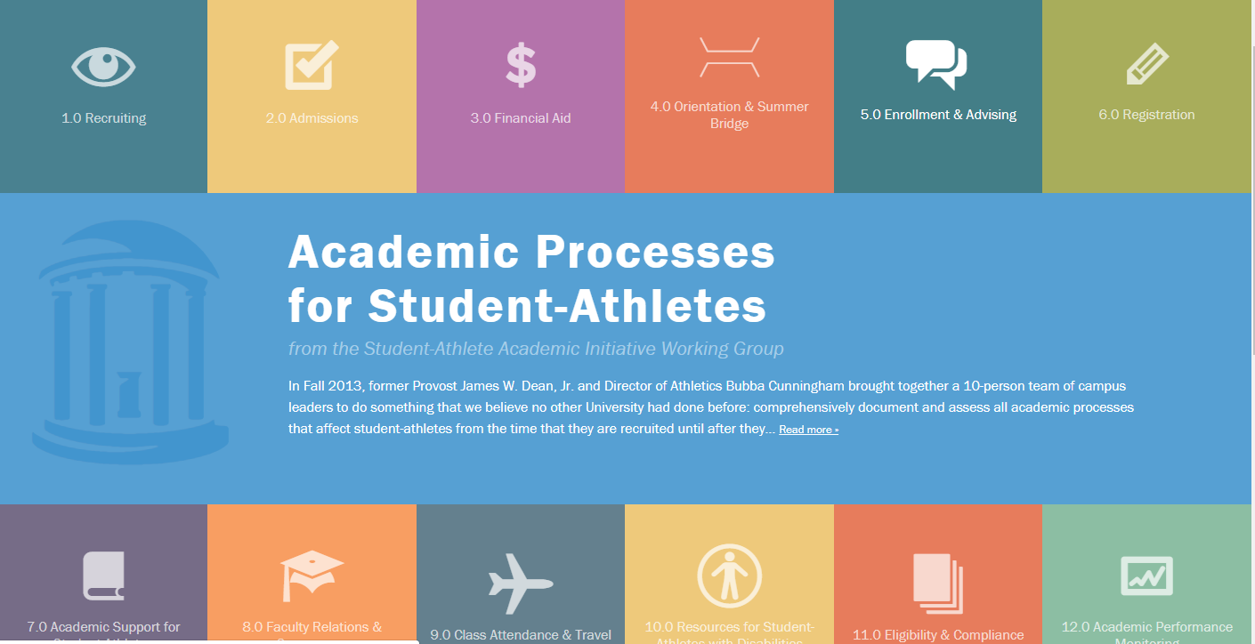
Process Review Group formerly, the Student-Athlete Academic Initiative Working Group https://apsa.unc.edu

Slide 5
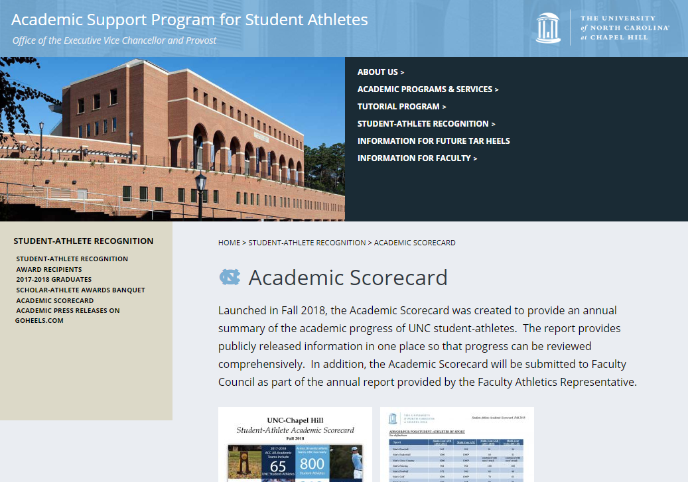
Academic Support Program for Student-Athletes
https://aspsa.unc.edu
Academic Scorecard – updated on a yearly basis.

Slide 6
Other Resources
Total Tar Heels, highlights the academic, service, and leadership accomplishments of our student-athletes
Available at https://goheels.com/ or
Contact Dana Gelin, dgelin@unc.edu to be placed on the mailing list
Carolina Spotlight, highlighting a rotating group of student-athletes, at the bottom of https://goheels.com/

Slide 7
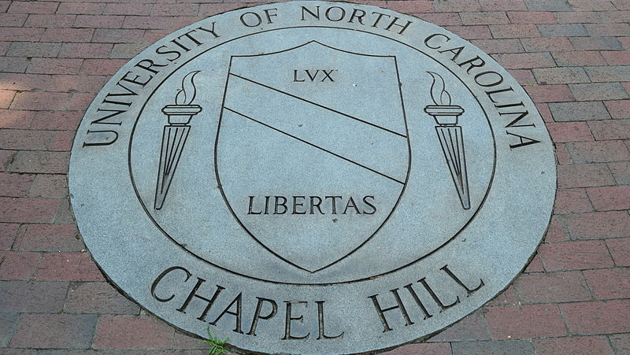
Comments, Questions or Concerns
Lissa Broome 919-962-7066 lbroome@email.unc.edu FAR@unc.edu

