Slide 1
In Memoriam

Slide 2
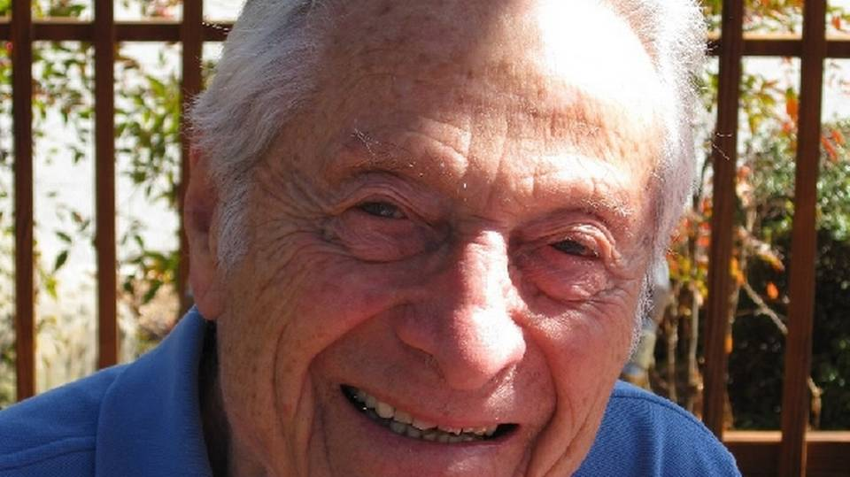
Samuel Haskell Baron
Professor Emeritus of English
Ph.D., 1952 (Columbia); M.A., 1948 (Columbia); B.S., 1942 (Cornell).
Appointed 1972; Died on August 16, 2017.

Slide 3
Helga Bister-Broonsen
Associate Professor Emerita of German
Ph.D. 1986 (Berkeley).
Appointed 1986;
Died on February 10, 2018.

Slide 4
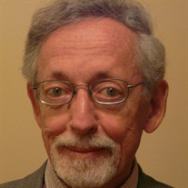
Edwin Louis Brown
Professor Emeritus of Classics
Ph.D., 1961, (Princeton); B.A., 1950, (Haverford).
Appointed 1961. Died March 27, 2017.

Slide 5
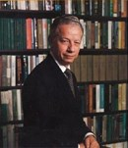
Professor Emeritus of Accounting
Ph.D., 1956 (Michigan); M.S., 1947 (Illinois); B.E., 1942 (Illinois State).
Appointed 1970; Died on July 30, 2017.
Richard Lee Brummet

Slide 6
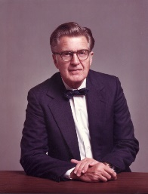
Paul Leslie Bunce
Professor Emeritus of Surgery
M.D., 1942 (Chicago); A.B., 1938 (Oberlin).
Appointed 1952; Died on March 18, 2017.

Slide 7
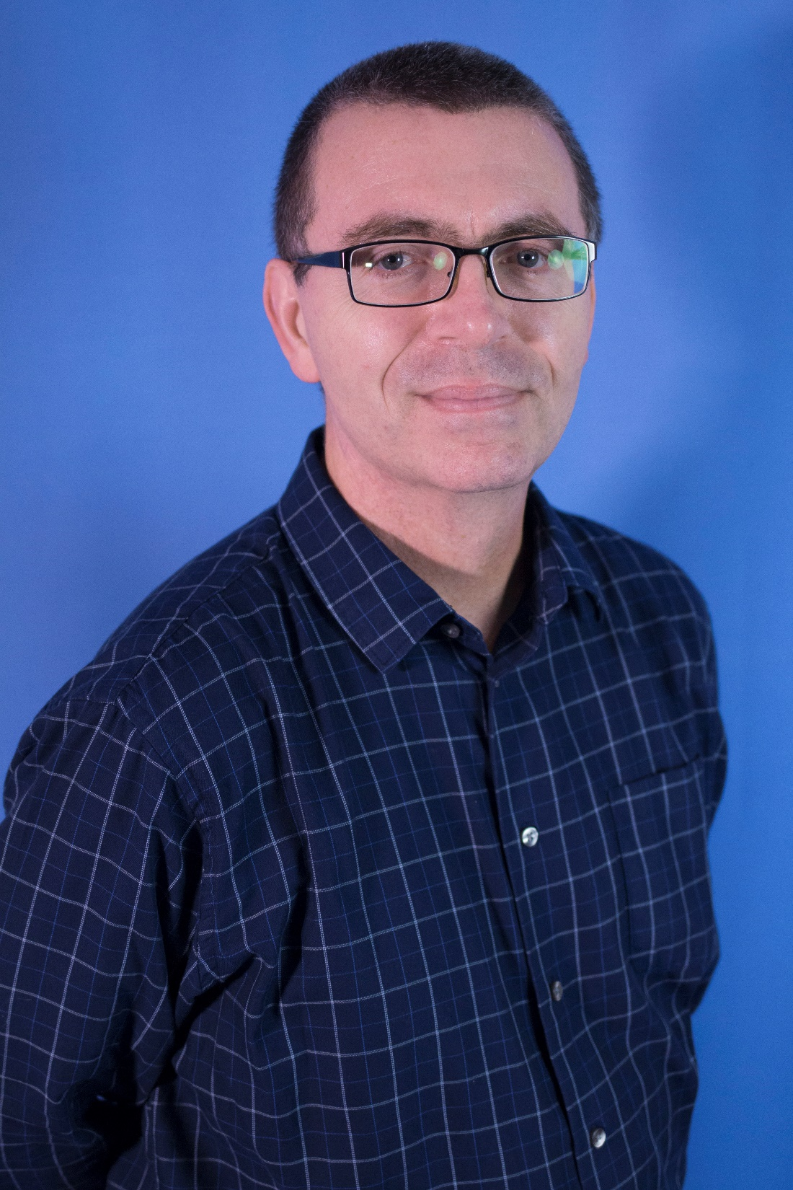
Thomas
Michael
Carsey
Professor of Political Science
PhD., 1995 (Indiana University).
Appointed 2006; Died on February 21, 2018.

Slide 8
Jason Davis
Assistant Professor of Geography
Ph.D., 2010 (Santa Barbara); M.E.M., 2003 (Duke); B.S., 1992 (Berkeley).
Appointed 2017; Died on April 1, 2018.

Slide 9
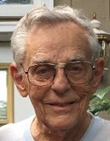
Frederick Louis Elbridge
Professor Emeritus of Medicine and Physiology
M.D., 1948 (Stanford); B.A., 1945 (Stanford).
Appointed 1973; Died on June 1, 2017.

Slide 10
Lawrence Irwin Gilbert
Professor Emeritus of Biology
Ph.D., 1958 (Cornell); M.S., 1955 (New York University); B.S., 1950 (Long Island University).
Appointed 1980; Died on October 31, 2017.

Slide 11
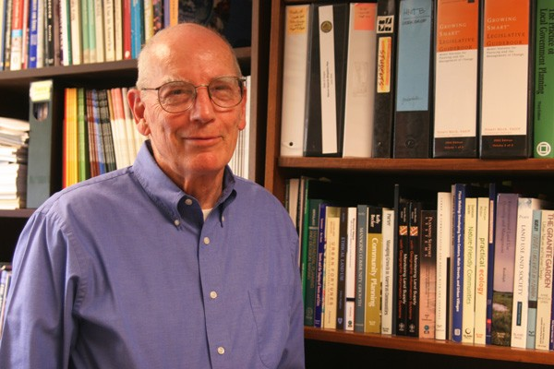
David Robinson Godschalk
Professor Emeritus of City and Regional Planning
Ph.D., 1971 (UNC-Chapel Hill); M.A., 1964 (UNC-Chapel Hill); B.A. 1959 (University of Florida); B.A (Dartmouth) 1953.
Appointed 1969; Died on January 27, 2018.

Slide 12
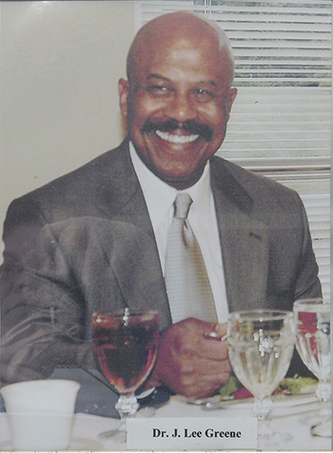
Johnny Lee Greene
Professor Emeritus of English
Ph.D., 1974 (UNC-Chapel Hill);
M.A., 1972 (UNC-Chapel Hill); B.A., 1967 (UNC-Chapel Hill).
Appointed 1975; Died on October 28, 2017.

Slide 13
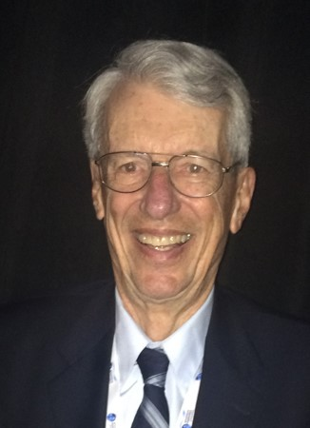
Thomas Hall
Professor Emeritus of Medicine
M.D. M.P.H., 1960 (Harvard), B.A. 1952 (Harvard).
Appointed 1971; Died on May 20, 2017.

Slide 14
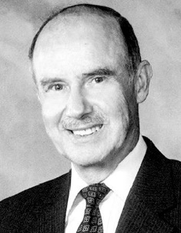
George F.
Hamilton
Professor Emeritus of Physiology
Ph.D., 1961 (University of Iowa); B.S., 1953 (University of Pennsylvania)
Appointed 1965; Died November 24, 2017

Slide 15
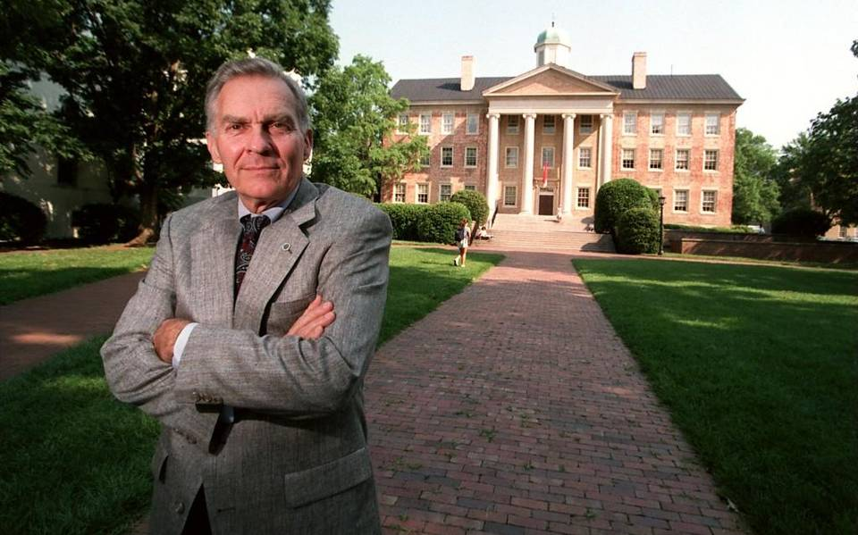
Paul Hardin, III
Chancellor Emeritus of the University of North Carolina at Chapel Hill
J.D., 1952 (Duke); B.A., (Duke).
Appointed 1988; Died on July 1, 2017.

Slide 16
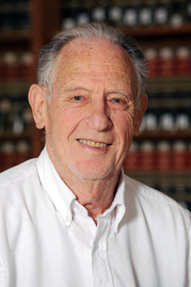
Paul Gershon Haskell
Professor Emeritus of Law
J.D., 1951 (Harvard); B.A, 1948 (Harvard).
Appointed 1977; Died March 7, 2018

Slide 17
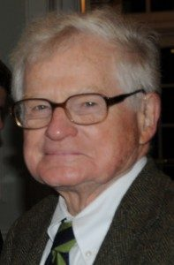
John Miles Headley
Professor Emeritus of History
Ph.D., 1960 (Yale); M.A., 1953 (Yale); B.A., 1951 (Princeton).
Appointed 1964; Died on September 22, 2017.

Slide 18
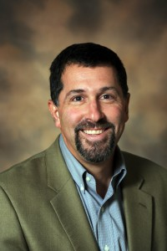
Jonathan
Hess
Professor of Germanic & Slavic Languages and Literatures
Ph.D., 1993 (University of Pennsylvania); M.A., 1989 (Johns Hopkins); B.A., 1987 (Yale).
Appointed 1993; Died on April 9, 2018.

Slide 19
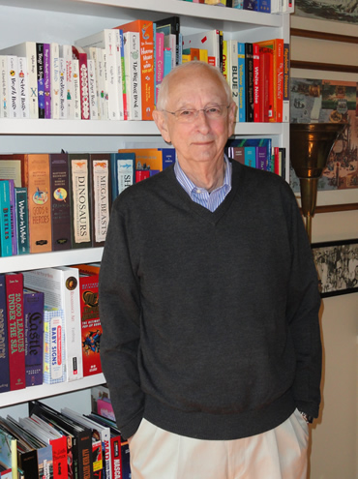
(Rucker) Sterling Hennis, Jr.
Professor Emeritus of Education
Ph.D., 1961 (UNC-Chapel Hill); M.A., 1953 (UNC-Chapel Hill); A.B., 1952 (UNC Chapel Hill).
Appointed 1961; Died on February 14, 2018.

Slide 20
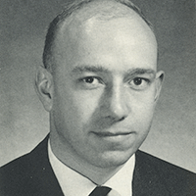
William Theodore Herzog
Professor Emeritus of Public Health
M.S.P.H., 1958 (UNC-Chapel); B.A., 1955 (Knox College)
Appointed 1964; Died on January 30, 2018

Slide 21
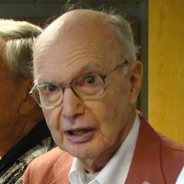
Berton Harris Kaplan
Professor Emeritus of Epidemiology
Ph.D., 1962; M.S., 1952 (UNC-Chapel Hill); B.S., 1951 (Virginia Polytechnic Institute).
Appointed 1960; Died on May 5, 2017.

Slide 22
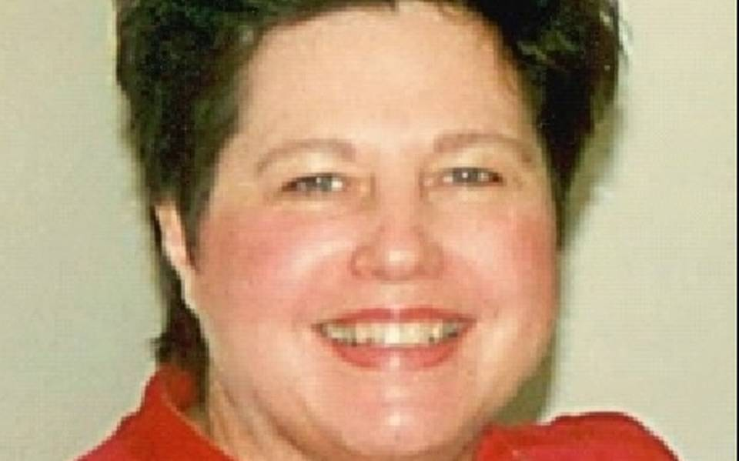
Diane Ruth Leonard
Professor of Comparative Literature
Ph.D., 1971 (UNC-Chapel Hill); A.B., 1965 (Marshall).
Appointed 1973; Died on September 30, 2017.

Slide 23
Barclay “Bob” C. Martin
Professor Emeritus of Clinical Psychology
Ph.D. 1953 (Stanford); B.S. 1949 (Stanford).
Appointed 1971
Died on February 2, 2018.

Slide 24
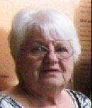
Brenda Morgan
Professor Emerita of Nursing
M.P.H., 1974 (UNC-Chapel Hill); B.S.N., (Illinois Wesleyan)
Appointed 1974; Died on July 20, 2017.

Slide 25
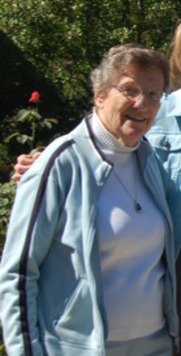
Charlene Mae Nelson
Associate Professor Emerita of Physical Therapy
M.A., 1964 (Duke); Cert. P.T., 1951 (Medical College of Virginia); B.S., 1951 (William & Mary).
Appointed 1961; Died May 11, 2017.

Slide 26
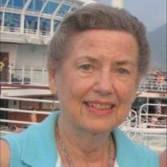
Barbara Nettles-Carlson
Associate Professor Emerita of Nursing
1979 (Indiana); M.P.H., 1977; B.S.N., 1970 (UNC-Chapel Hill).
Appointed 1973; Died on June 5, 2017.

Slide 27
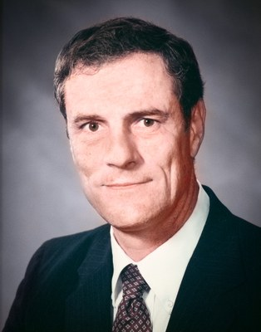
David Ainsworth Ontjes
Professor Emeritus of Medicine and Pharmacology
M.D., 1964 (Harvard); M.A., 1961 (Oxford); B.A., 1959 (Kansas).
Appointed 1969; Died on May 7, 2017.

Slide 28
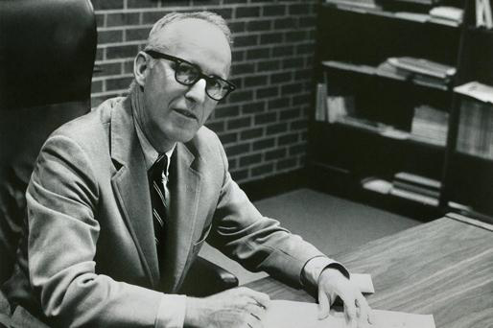
James Dickson Phillips, Jr.
Professor Emeritus of Law
J.D., 1948 (UNC-Chapel Hill); B.A., 1943 (Davidson College).
Appointed 1960; Died on August 27, 2017.

Slide 29
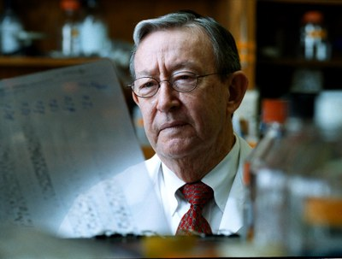
Harold Ross Roberts
Professor Emeritus of Medicine and Pathology
M.D., 1955 (UNC-Chapel Hill); B.S., 1952 (UNC-Chapel Hill).
Appointed 1961; Died on September 9, 2017.

Slide 30
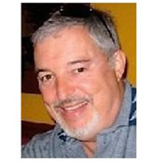
Richard Hyman Shachtman
Professor Emeritus of Public Health
Ph.D., 1968 (University of Maryland); B.S., 1963 (University of Maryland).
Appointed 1973; Died on June 24, 2017.

Slide 31
Stephen Morrison Shafroth
Professor Emeritus of Physics
Ph.D., 1953 (Johns Hopkins); B.A., 1947 (Harvard).
Appointed 1967; Died on July 20, 2017.

Slide 32
Richard Lee (Dick) Simpson
Professor Emeritus of Sociology
PhD. 1956 (UNC-Chapel Hill); M.A., 1952 (Cornell); B.S., 1950 (UNC-Chapel Hill).
Appointed 1956; Died on December 30, 2017

Slide 33
Joseph St. Jean, Jr.
Professor Emeritus of Geology.
Ph.D., 1956 (Indiana); M.A., 1953 (Indiana); B.S., 1949 (College of Puget Sound).
Appointed 1957; Died March 7, 2018.

Slide 34
Harvey Maurice Wagner
Professor Emeritus of Operations Research and Management Science
Ph.D., 1960 (MIT); M.S., 1954 (Stanford); B.S., 1953 (Stanford).
Appointed 1976; Died on July 23, 2017.

Slide 35
Robert Henry Wilkins
Professor of Neurosurgery
M.D., 1959 (University of Pittsburgh); B.S., 1955 (University of Pittsburgh).
Appointed 2012; Died on March 31, 2017.

