Slide 1
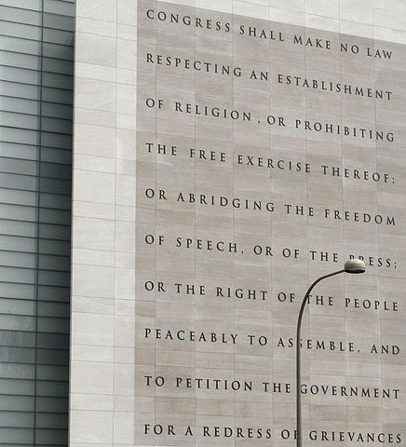
By dbking - _MG_7346, CC BY 2.0, https://commons.wikimedia.org/w/index.php?curid=4526478
Notes:
Many of you have probably heard about the Chicago Principles, a statement set out by a task force at the University of Chicago in 2015 that was adopted by their faculty. These principles received a lot of press at the time and have continued to as there have continued to be concerns about speech on campuses across the country. Close to 40 colleges and universities have adopted them, some with their own revisions and some adopting the Chicago statement as it stood.
As you read in Dr. Parise's letter that accompanies our resolution. This issue came to us because a faculty member in the School of Business came to the FEC and wanted to talk about bringing a resolution to faculty council about this. Coincidentally, student groups have been bringing this up as well. In response, the CWG was formed to take a deeper dive into these principles, learn more about what they did and didn't address, how they were created, and consider implications of adopting them, modifciations we might want to make to them, etc.

Slide 2
Communications Work Group Members:
Mimi V. Chapman, Professor, School of Social Work
Michael J. Gerhardt, Samuel Ashe Distinguished Professor of law
Shayna Hill, Chair of the University of North Carolina at Chapel Hill Employee Forum
Benny Joyner, Associate Clinical Professor, Department of Pediatrics
Mark McNeilly, Professor of the Practice, marketing and Organizational Behavior, Kenan-Flagler Business School
John McGowan, John W. and Anna H. Hanes Professor of English and Comparative Literature
Jill D. Moore, Associate Professor of Public Law and Government, School of Government
Richard Myers, Henry Brandis Distinguished Professor of Law, School of Law
Gloria D. Thomas, Director, Carolina Women’s Center
Lindsie D. Trego, Masters Candidate in the School of Media and Journalism and J.D. candidate in the School of Law
Notes:
Dr. Parisie asked me to chair the CWG and I was honored to do so. Together we sought to quickly put together a group that would bring expertise, differing viewpoints, and represent different constituencies together. There were a number of people we approached who could not participate at the time. Some recommended other people and some have consulted after the fact on the resolution itself. As you can see, the workgroup is lawyer heavy. It was important to me to make sure that there were people on the committee who understood the first ammendment in very deep ways in order to keep our group on track. It was a group that came together quickly, many of us did not know each other well, and committed a lot of time to work on the question of whether to adopt these principles, how they should or should not be changed, etc. Most of them are here today. Please stand up and be recognized for your hard work.

Slide 3
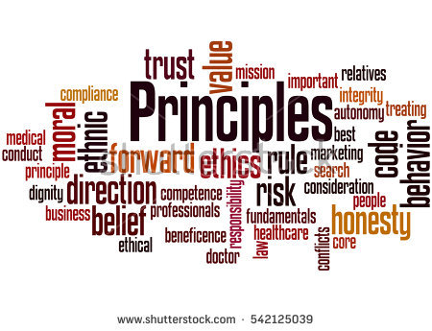
Principle versus Policy
Notes:
The first thing we had to be clear on as a group is that we were looking at principles, not policies. These principles talk about what we aspire to, what we believe in, what we think is valuable, not what should be done or not done in a particular situation. They might guide a conversation about the creation of a policy, but they are not policies and not binding in any way.

Slide 4
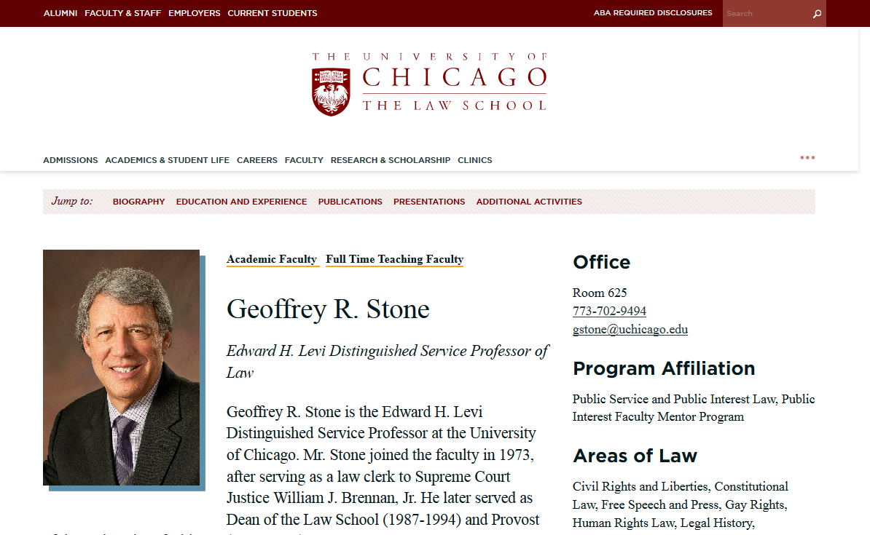
Notes:
So during our full day retreat, we asked Geoff Stone of the University of Chicago to join us by zoom. He chaired the group that wrote the principles and we wanted to know what their process was like to arrive at the principles and how he thought the principles had made a difference. As a group, we talked with him for about 45 minutes. He told us that their group's work had taken 9 months, he discussed how carefully the principles had been crafted from a legal perspective, and gave examples of how the principles had "set the tone" for thinking about issues that had since come up on campus. After that, we made a decision as a group to move forward with trying to draft a document that would put the Chicago principles, as written, in a Carolina context.

Slide 5
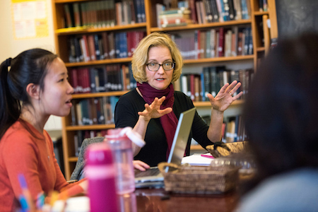
Notes:
Before I talk about why I believe it would be beneficial to adopt these principles, I want to talk for a moment about what they will not do. They do not protect speech that is harassment. They do not dictate whether or not Jane can use trigger warnings in her classroom. They do not address whether or not someone should be hired or tenured. They do not prevent protest.

Slide 6
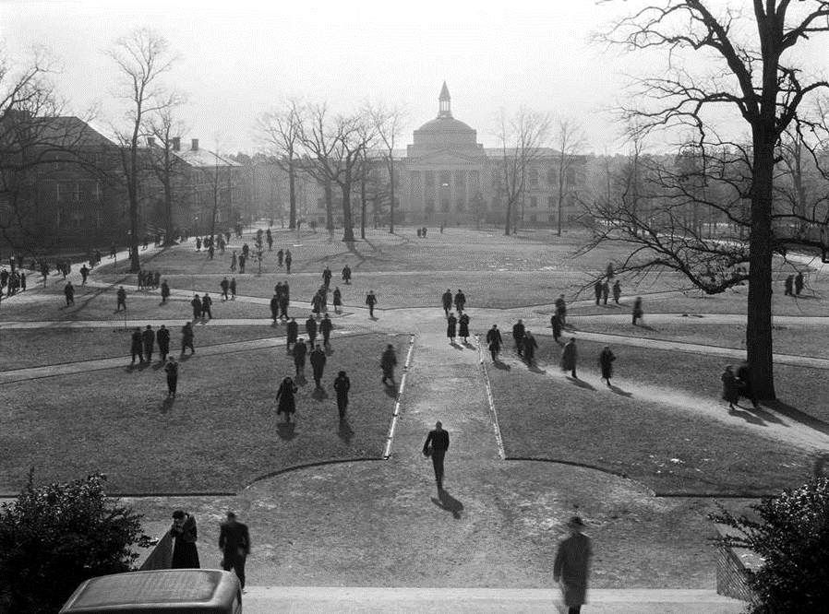
Notes:
They are about supporting the right to speech "in the public square" and the right to peacefully protest and debate the issues raised that speech if one is in disagreement with it. It does not mean that any and all speakers must be allowed to come to campus if they want to. Remember, these are principles not policies. Questions of public safety, referred to legally as "time, place, and manner" are unaffected by these principles.

Slide 7
The intolerant fifth
Free speech at American universities is under threat
But fears of a pandemic of snowflakery are overwrought
The Economist, October 12, 2017
Notes:
Some people have raised the question, do we need these? It's a good question and one I struggled with a lot myself. Put another way, are these principles a solution in search of a problem? My answer is maybe. We have not surveyed our campus to find out how students here think about speech. We have not systematically questioned faculty about their views or experiences. However, among the public, as the article from the Economist points out, there is a perception that there is an issue with speech on college campuses. (This article actually contains real data by the way that shows that college students over all, are not much different than the general public in their views on speech of various types.) But perception is important and sometimes as group, we have to deal with a perception as much as reality. I believe these principles help us do that.
Also, the question of whether to adopt these very well formed principles that are completely in keeping with our constitution is before us because individual students and faculty are bringing it to us. To answer no, because we're not sure whether or not there is a problem, becomes a problem in and of itself.

Slide 8
Notes:
So, to conclude, our group has worked diligently to think deeply about and consider these principles and we recommend adoption of them to you.

