Slide 1
THE BLUEPRINT for NEXT
Carolina’s Strategic Framework
Notes:
Greetings – set context for a one hour meeting
Started 3 years ago
Meld and synthesize for a strategic imperative (essential and rather urgent)
Process to align and develop inputs and consolidated them into a focused -- and genuinely strategic – framework
Want you to help help refine, and elaborate them further
My convictions about what Carolina stands for and why I’ve shaped today’s draft as I have; what’s especially important to the institution and its constituents now; and why we’re creating a “framework” rather than a “plan”

Slide 2
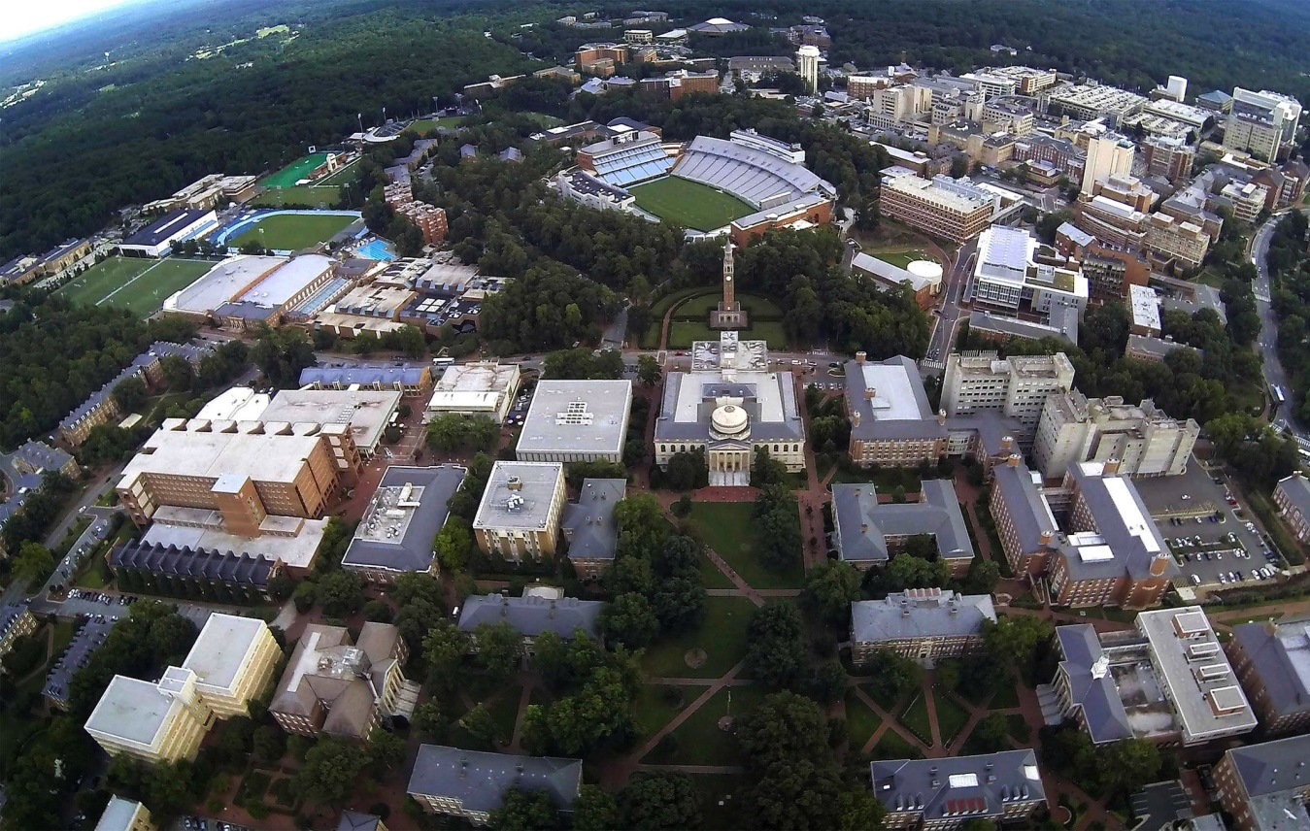
ENGAGING CAMPUS
Pan-university working groups
School & unit planning
Enrollment growth study
Staff, faculty & student forums
Trios & CPC meetings
Concurrent System planning

Slide 3
Of the public,
for the public
No barriers to a great education
Expertise for state & beyond
Work for public good & democracy

Slide 4
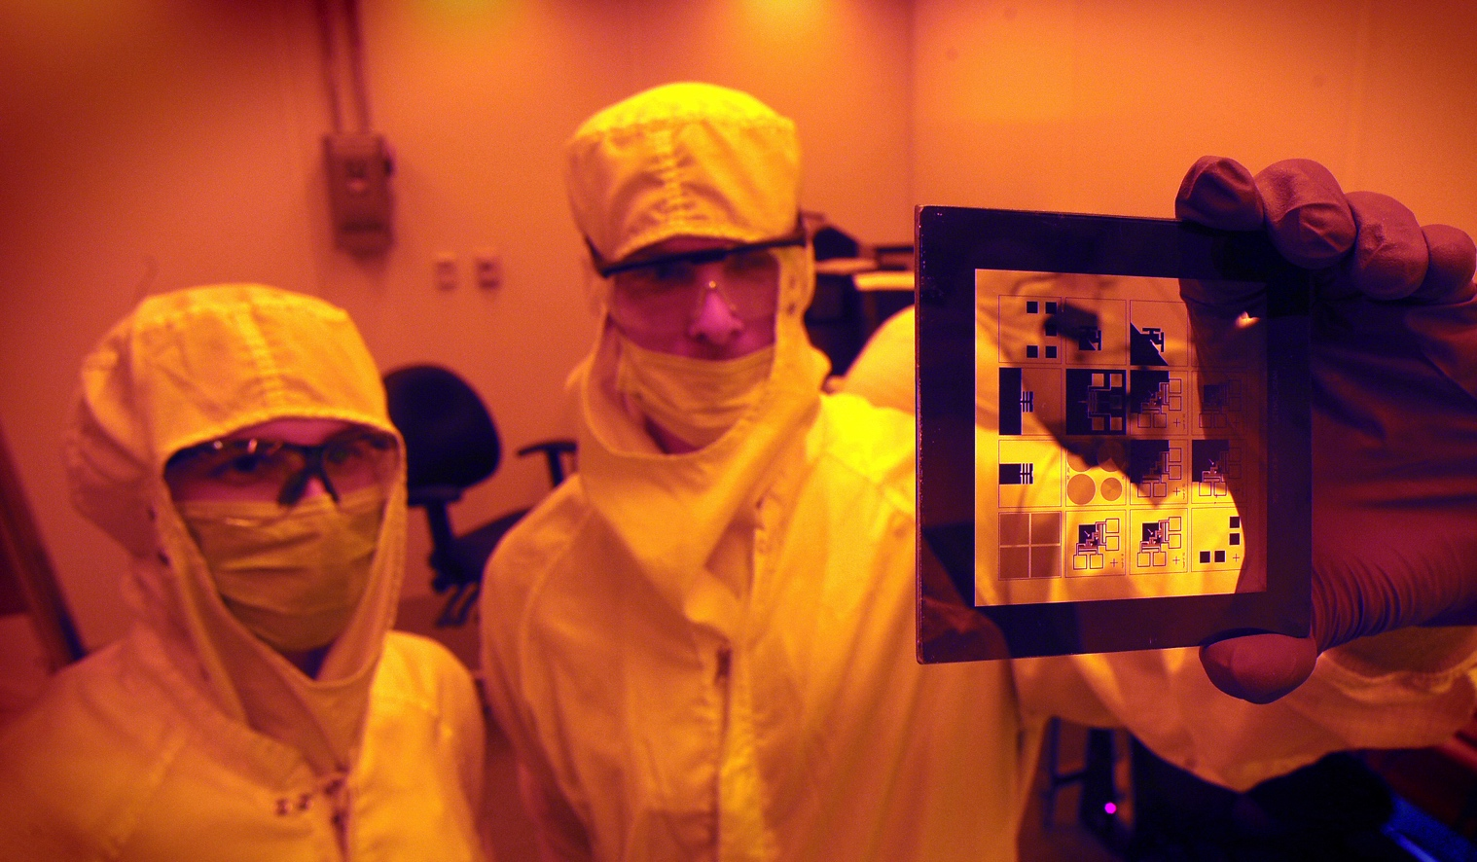
Innovation made fundamental
Fundamental, creative
New learning imperative
Translating research
Adapting & evolving workforce and student needs

Slide 5
OTHER emerging
INITIATIVES
Culture of Innovation
The Great Convergence
Computer Science, Applied Physical Science & Biomedical Engineering
Economic Generators
The New Graduate
Creativity Hubs
Traditional Students
Arts Everywhere
new curricula, new experiences
Non-Traditional Students
new learning model, expanded scope
Carolina Whole Health
Job Readiness
certificates, specific skills, emerging fields

